Slide 1
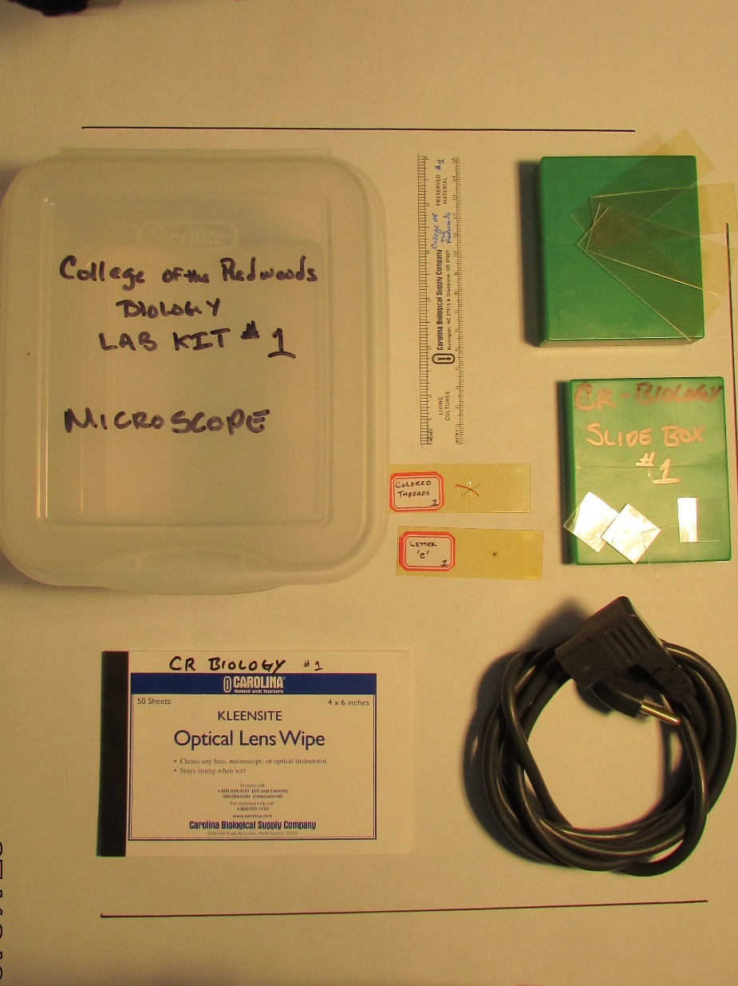

College of the Redwoods – Biology
1
4
5
7
6
8
2
3
MICROSCOPE LAB KIT
INVENTORY
1 plastic ruler
1 book of optical lens paper
1 AC power cord
1 slide box
4 blank plastic microscope slides
4 plastic slide cover slips
1 prepared slide (colored threads)
1 prepared slide (letter ‘e’)
1

Slide 2
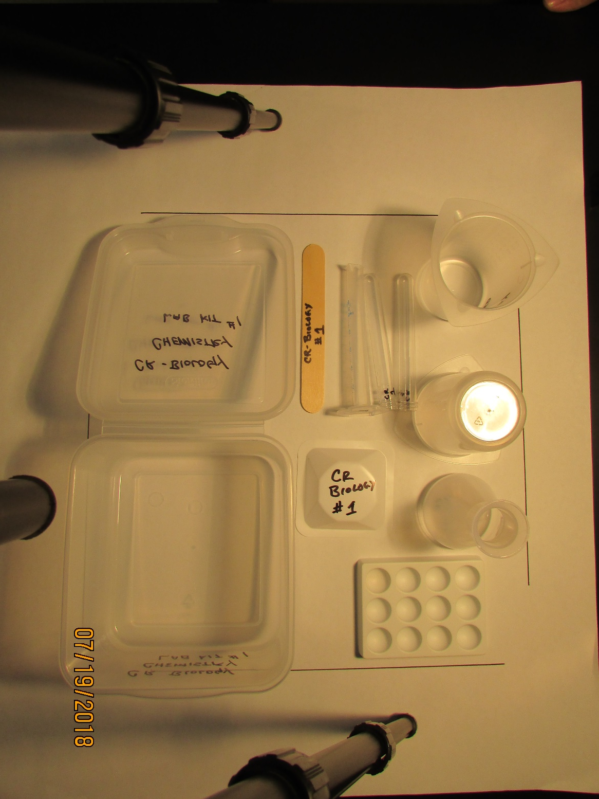
College of the Redwoods – Biology
1
2
3
4
5
6
7
CHEMISTRY LAB KIT
INVENTORY
1 wooden tongue depressor
1 plastic graduated cylinder (10 ml)
2 plastic test tubes
2 plastic tri-pour beakers (250 ml)
1 plastic Erlenmeyer flask (100 ml)
1 medium plastic weigh boat
1 plastic spot plate
2

Slide 3
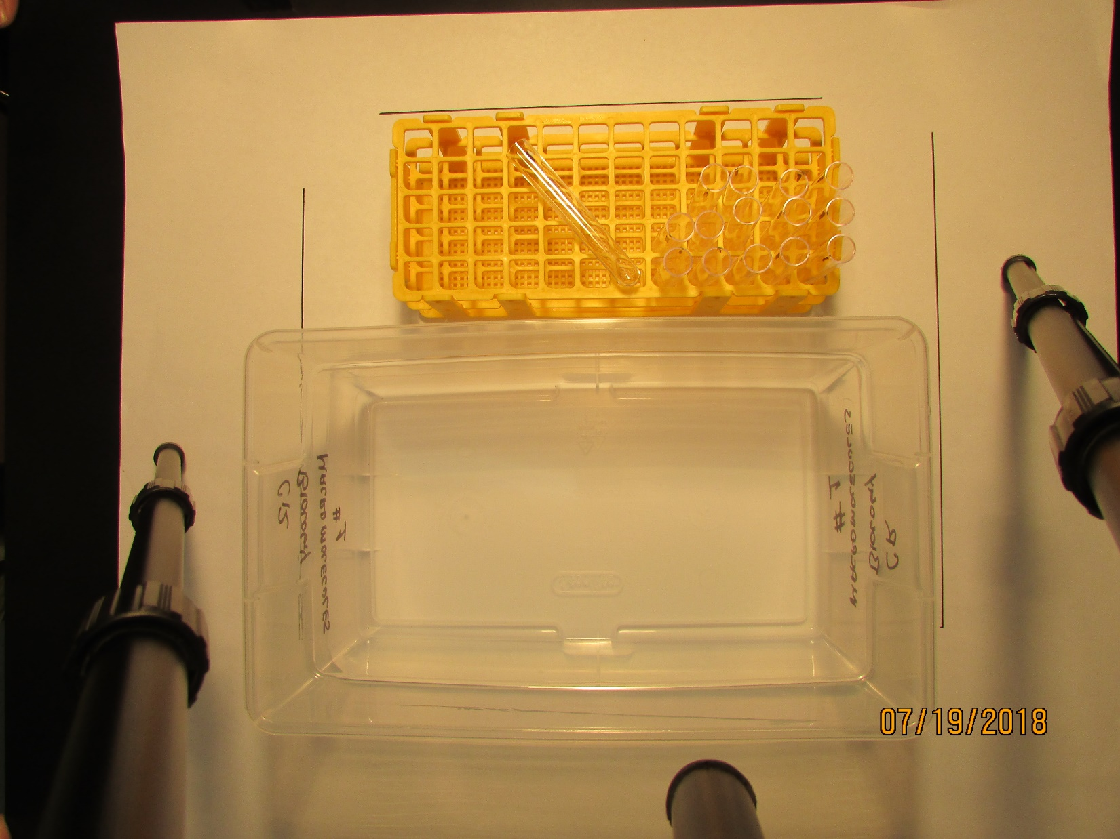
College of the Redwoods – Biology
2
1
MACROMOLECULE LAB KIT
INVENTORY
1 test tube rack
15 plastic test tubes
3

Slide 4
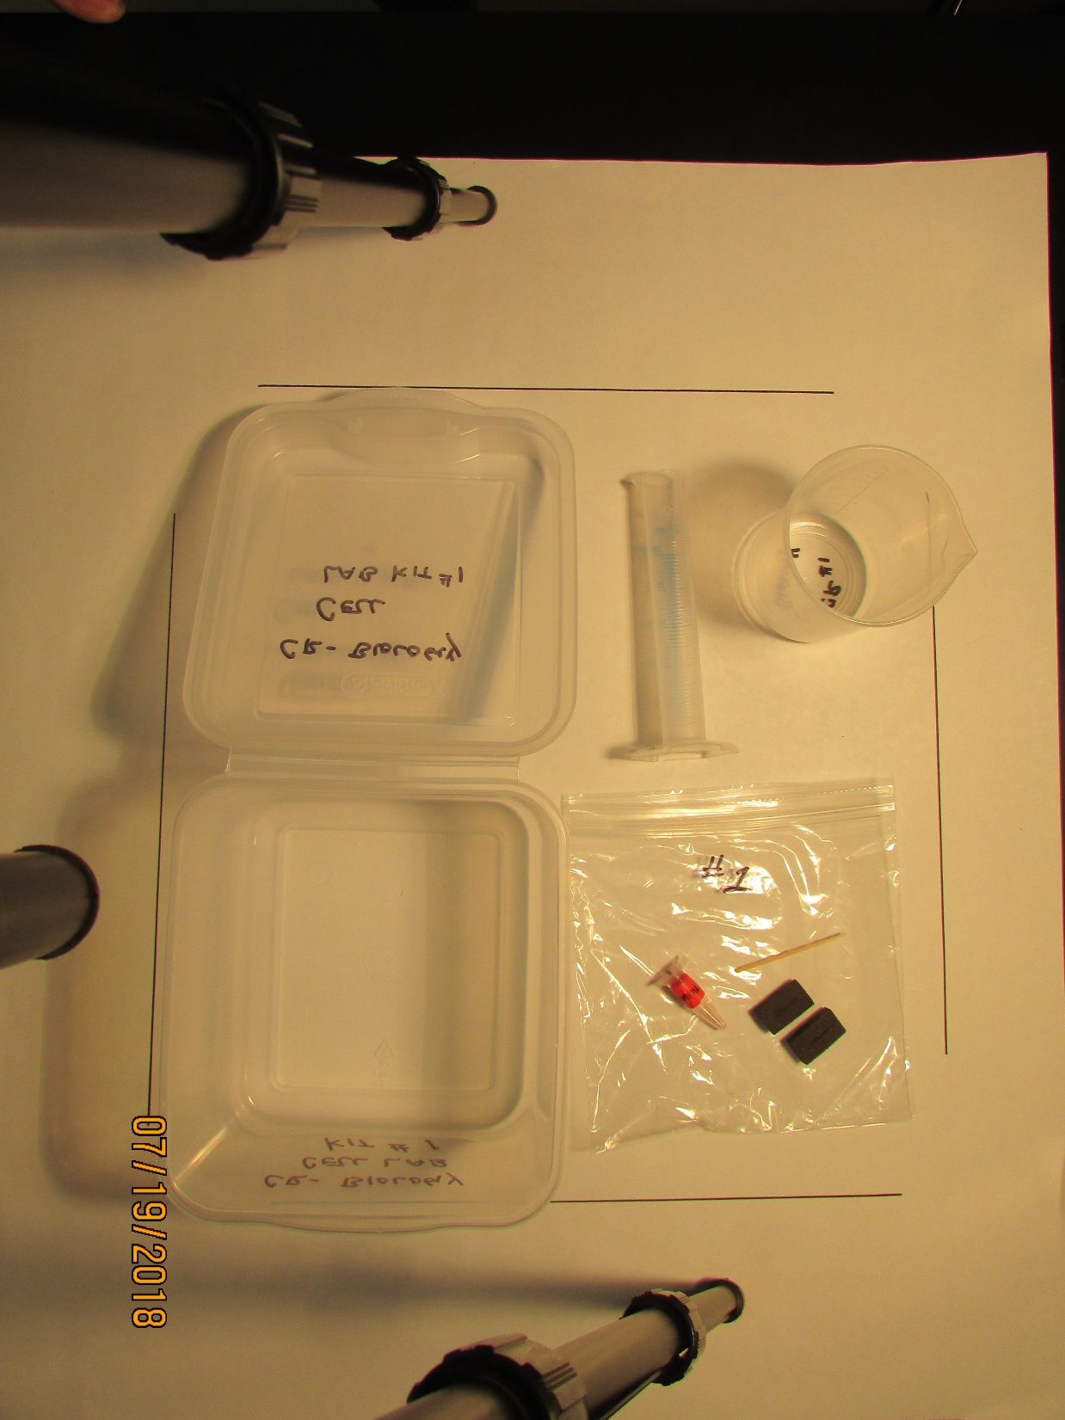
College of the Redwoods – Biology
1
2
1
3
5
4
6
CELL LAB KIT
INVENTORY
1 plastic graduated cylinder (25 ml)
1 plastic beaker (300 ml)
1 small zip-lock bag
1 flat wooden tooth pick
1 small plastic tube of carmine red powder
2 foam stoppers
4

Slide 5
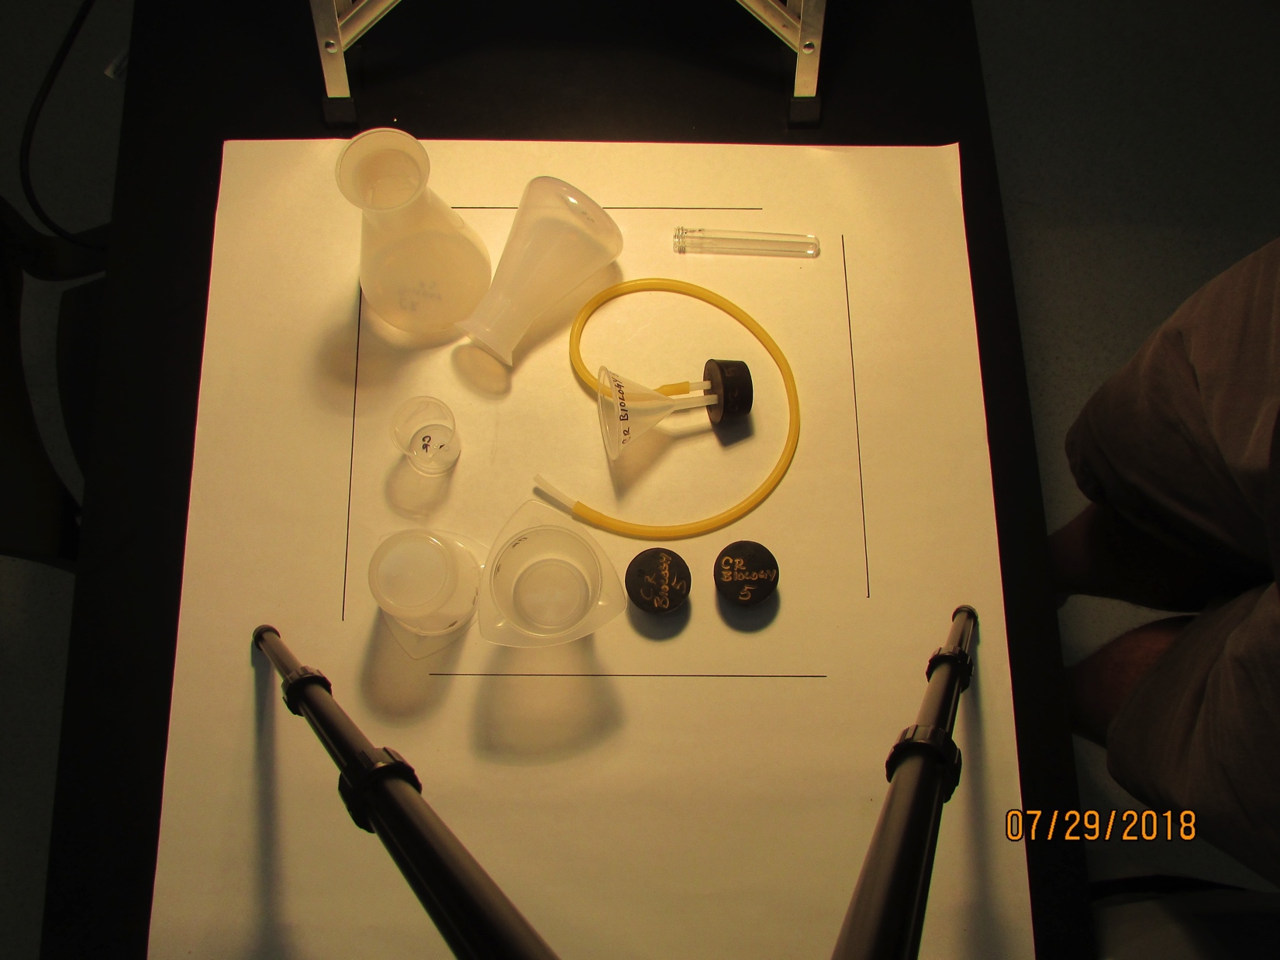
College of the Redwoods – Biology
2
5
4
6
1
3
CELL RESPIRATION LAB KIT
INVENTORY
2 plastic tri-pour beakers (250 ml)
2 plastic Erlenmeyer flasks (500 ml)
2 rubber stoppers #10
1 gas funnel apparatus (5 pieces total; rubber stopper, plastic funnel, surgical tube, 2 plastic inserts)
1 plastic test tube
1 plastic beaker (50 ml)
5

Slide 6
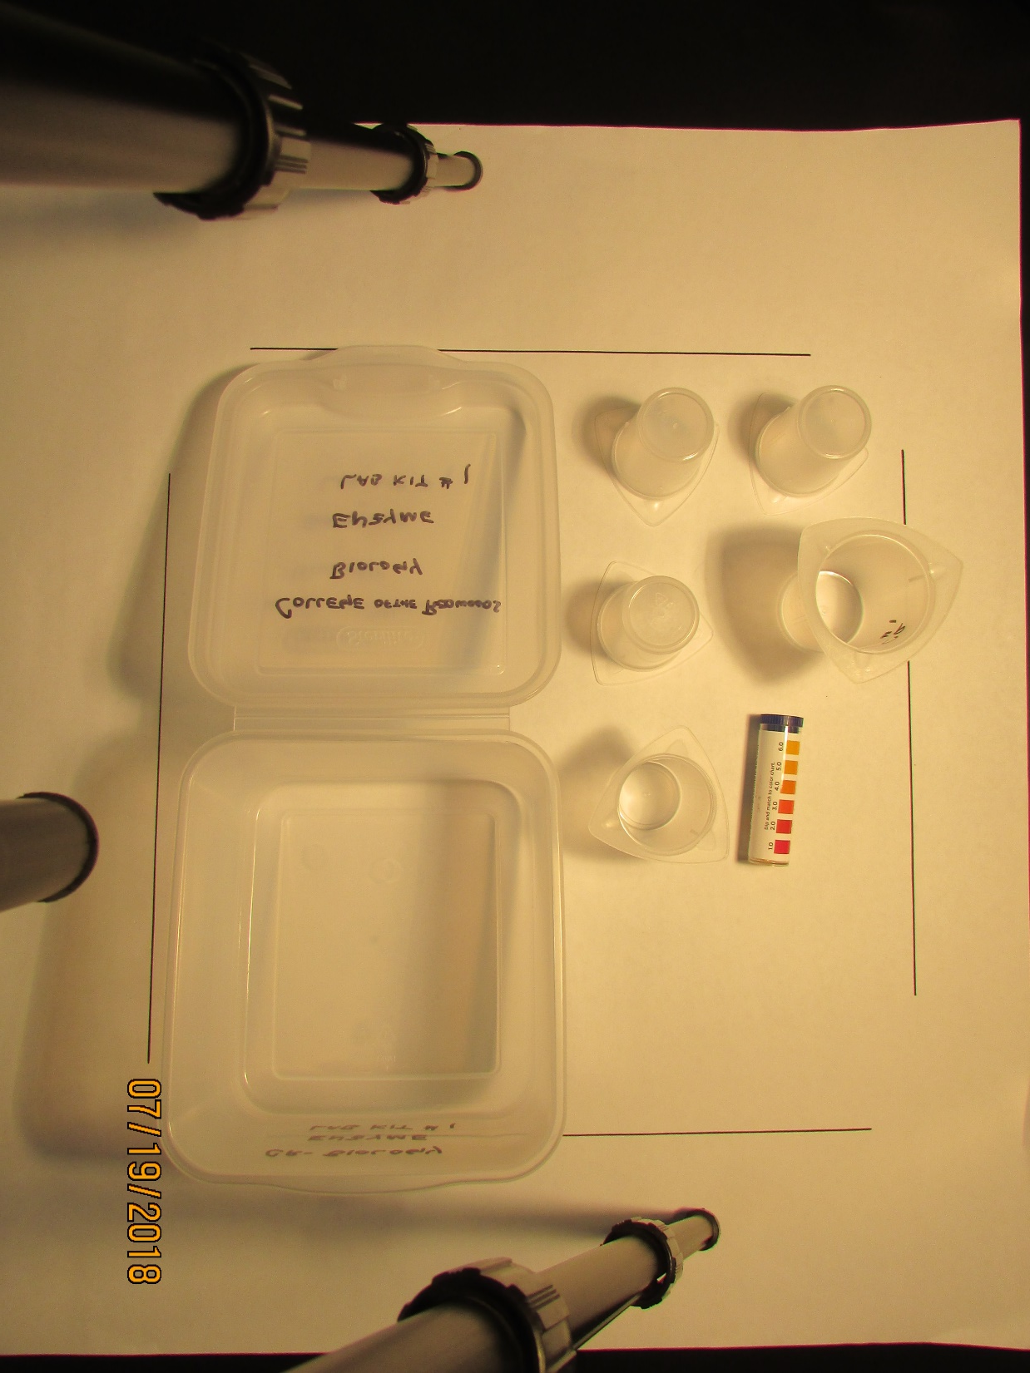
College of the Redwoods – Biology
1
1
2
3
ENZYME LAB KIT
INVENTORY
4 plastic tri-pour beakers (50 ml)
1 tri-pour beaker (100 ml)
1 tube pH test paper (Hydrion)
6

Slide 7
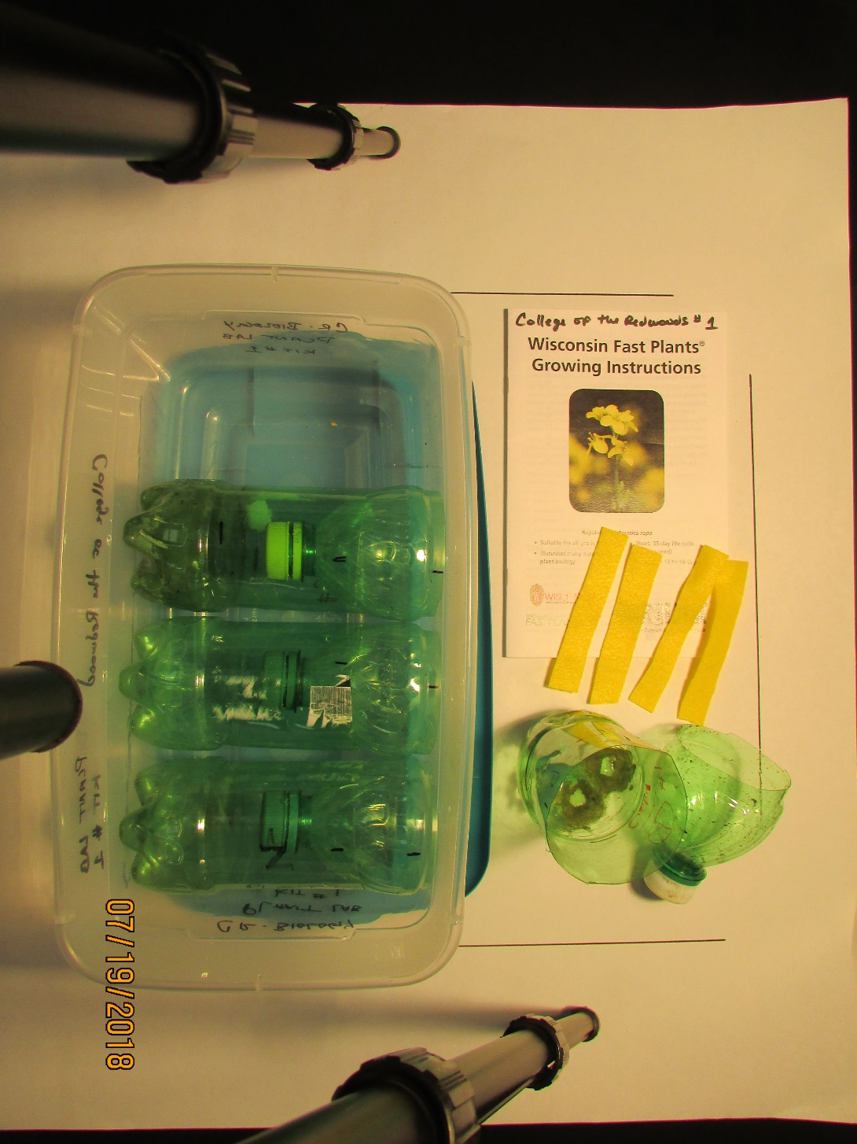
College of the Redwoods – Biology
1
3
2
3
PLANT LAB KIT
INVENTORY
1 Fast Plant instruction book
4 felt wicks
4 soda bottles cut in half (20 oz)
7

Slide 8
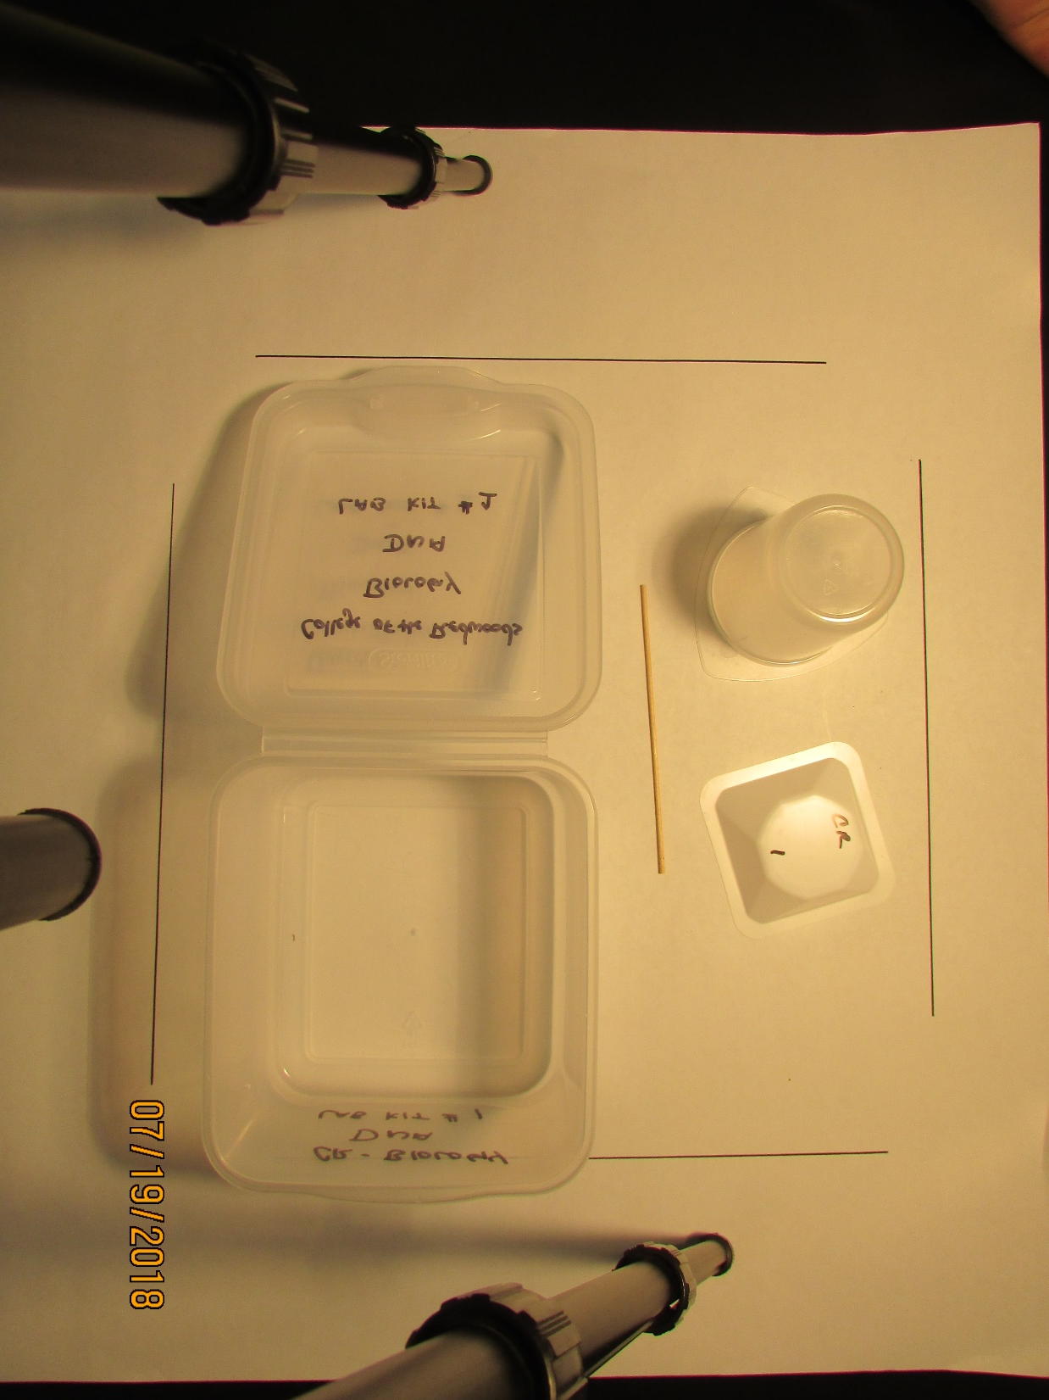
College of the Redwoods – Biology
1
2
3
DNA LAB KIT
INVENTORY
1plastic tri-pour beaker (250 ml)
1 wooden stint
1 medium plastic weigh boat
8

Slide 9
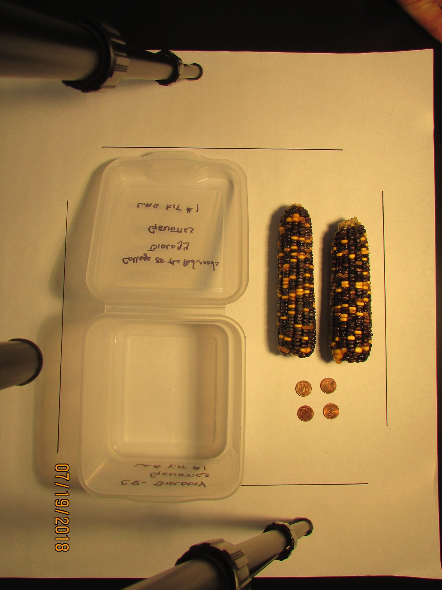
College of the Redwoods – Biology
1
2
GENETICS LAB KIT
INVENTORY
2 ears of dried corn
4 pennies
9

Slide 10
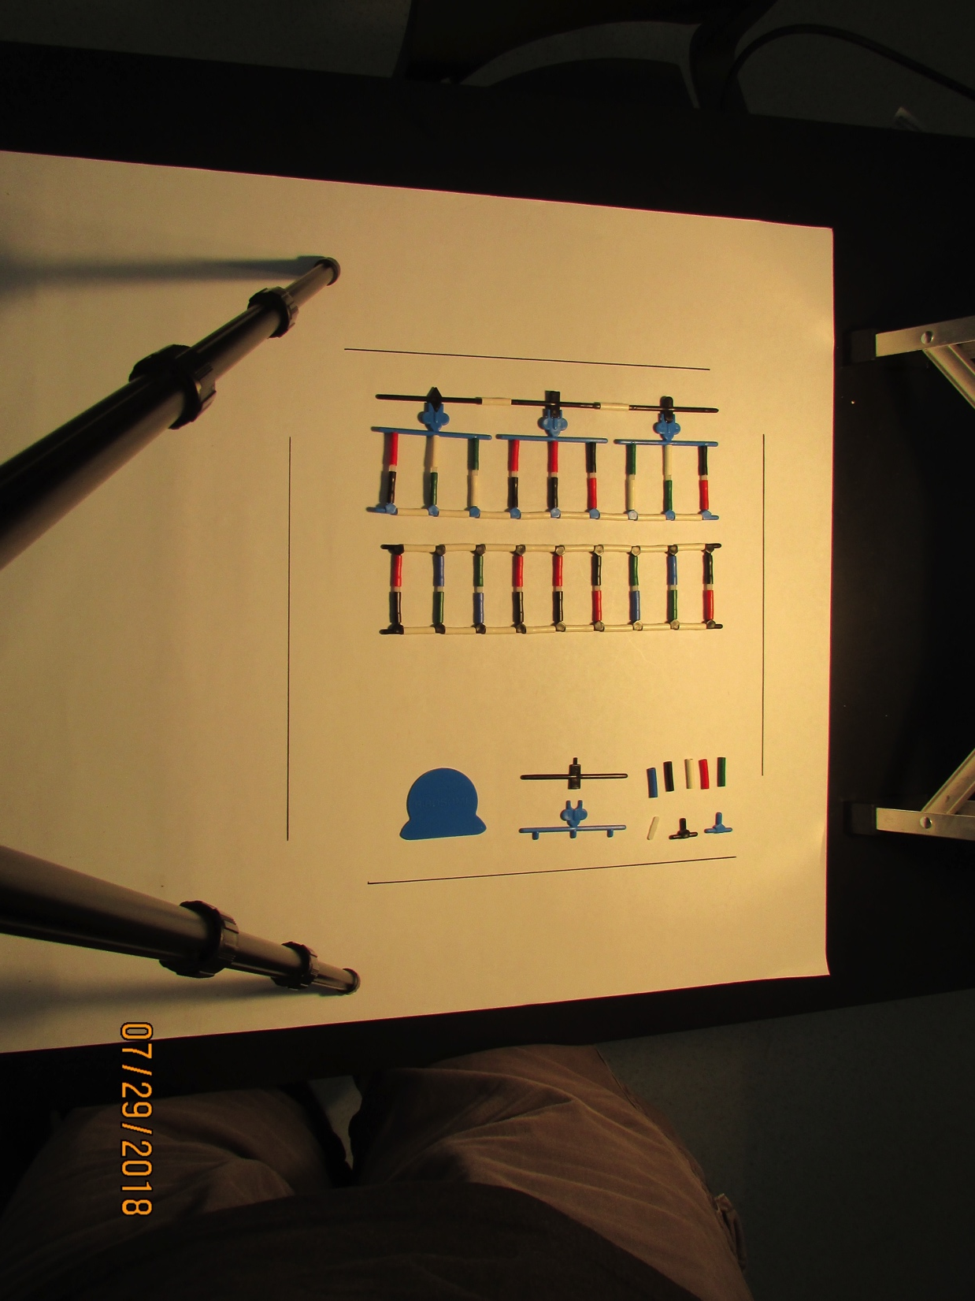
College of the Redwoods – Biology
1
2
Protein LAB KIT
INVENTORY
Assembled Protein/DNA model
Disassembled Protein/DNA model (114 pieces total)
Each kit has two model sets in zip-lock bags. Students must turn in kits assembled with all 114 pieces.
10

Slide 11
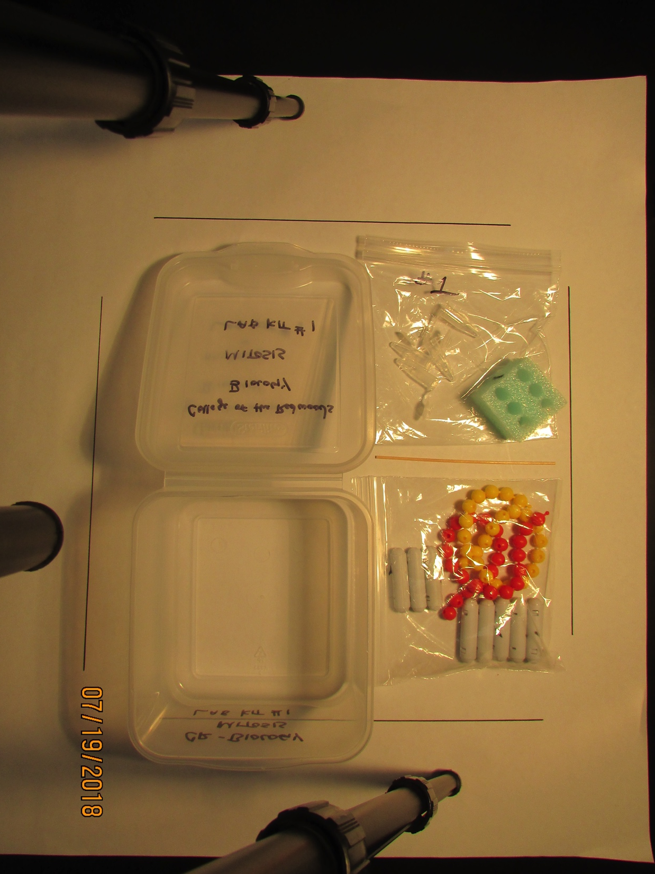
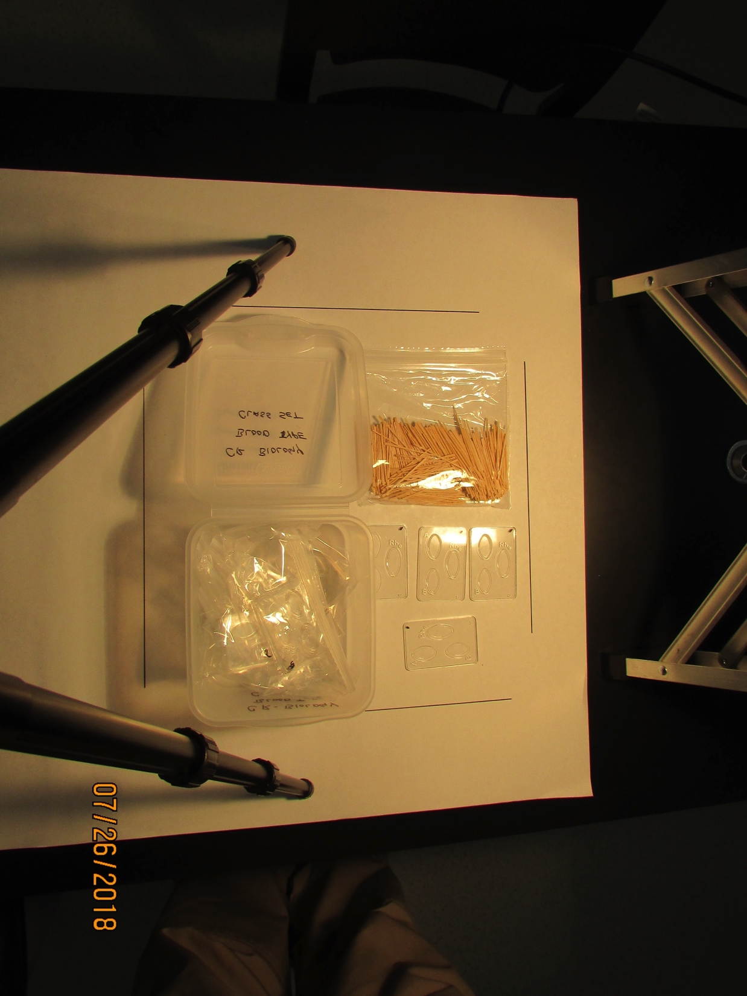
College of the Redwoods – Biology
1
2
MITOSIS LAB KIT
INVENTORY
2 zip-lock bags 4. 8 magnets
4 microcentrifuge tubes 5. 24 red pop beads
1 foam block 6. 24 yellow pop beads
BLOOD TYPE LAB KIT
INVENTORY
1 zip-lock bag with 500 flat wooden tooth picks
6 zip lock bags each with 4 plastic blood trays
11

Slide 12
College of the Redwoods – Biology
1
2
3
7
6
5
4
MITOSIS LAB KIT
INVENTORY
1. 2 zip-lock bags 5. 24 red pop beads
2. 4 microcentrifuge tubes 6. 24 yellow pop beads
3. 1 foam block 7. 1 wooden stint
4. 8 magnets
12

Slide 13
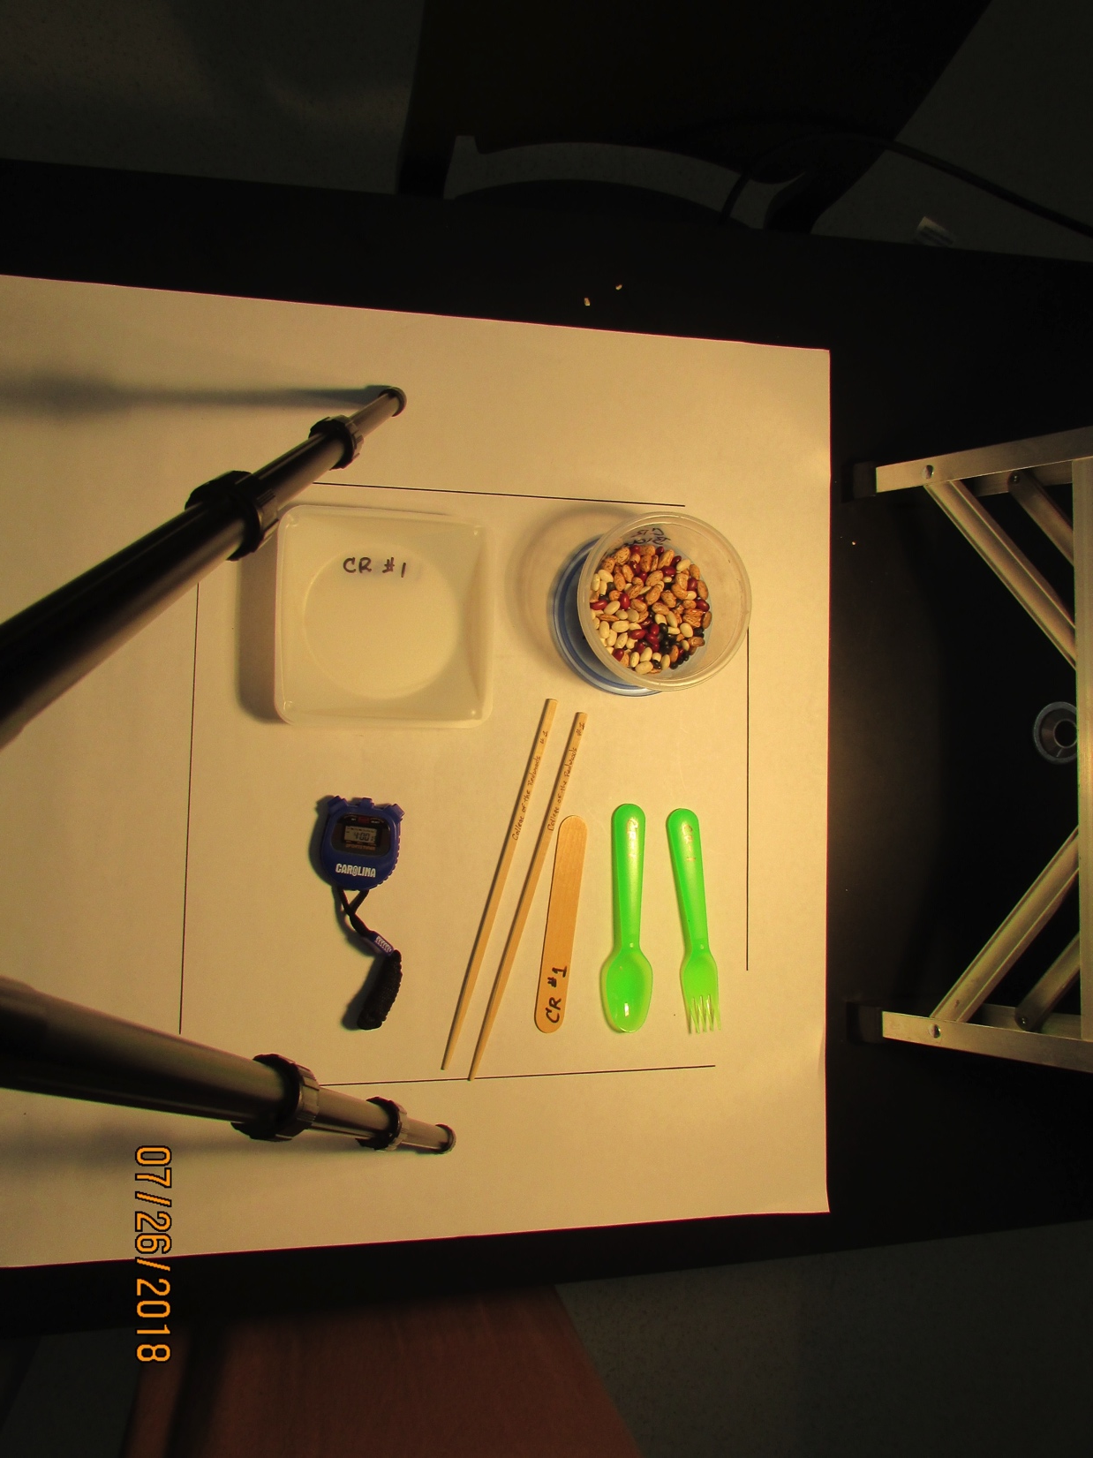
College of the Redwoods – Biology
7
2
3
1
5
6
4
EVOLUTION LAB KIT
INVENTORY
1 stop watch 5. 1 plastic spoon
4 large weigh boats 6. 1 wooden tongue depressor
1 pair of wooden chop sticks 7. 1 plastic Tupperware w/ lid
1 plastic fork (all items in large zip-lock bag)
Large tub is filled with vermiculite
13

Slide 14
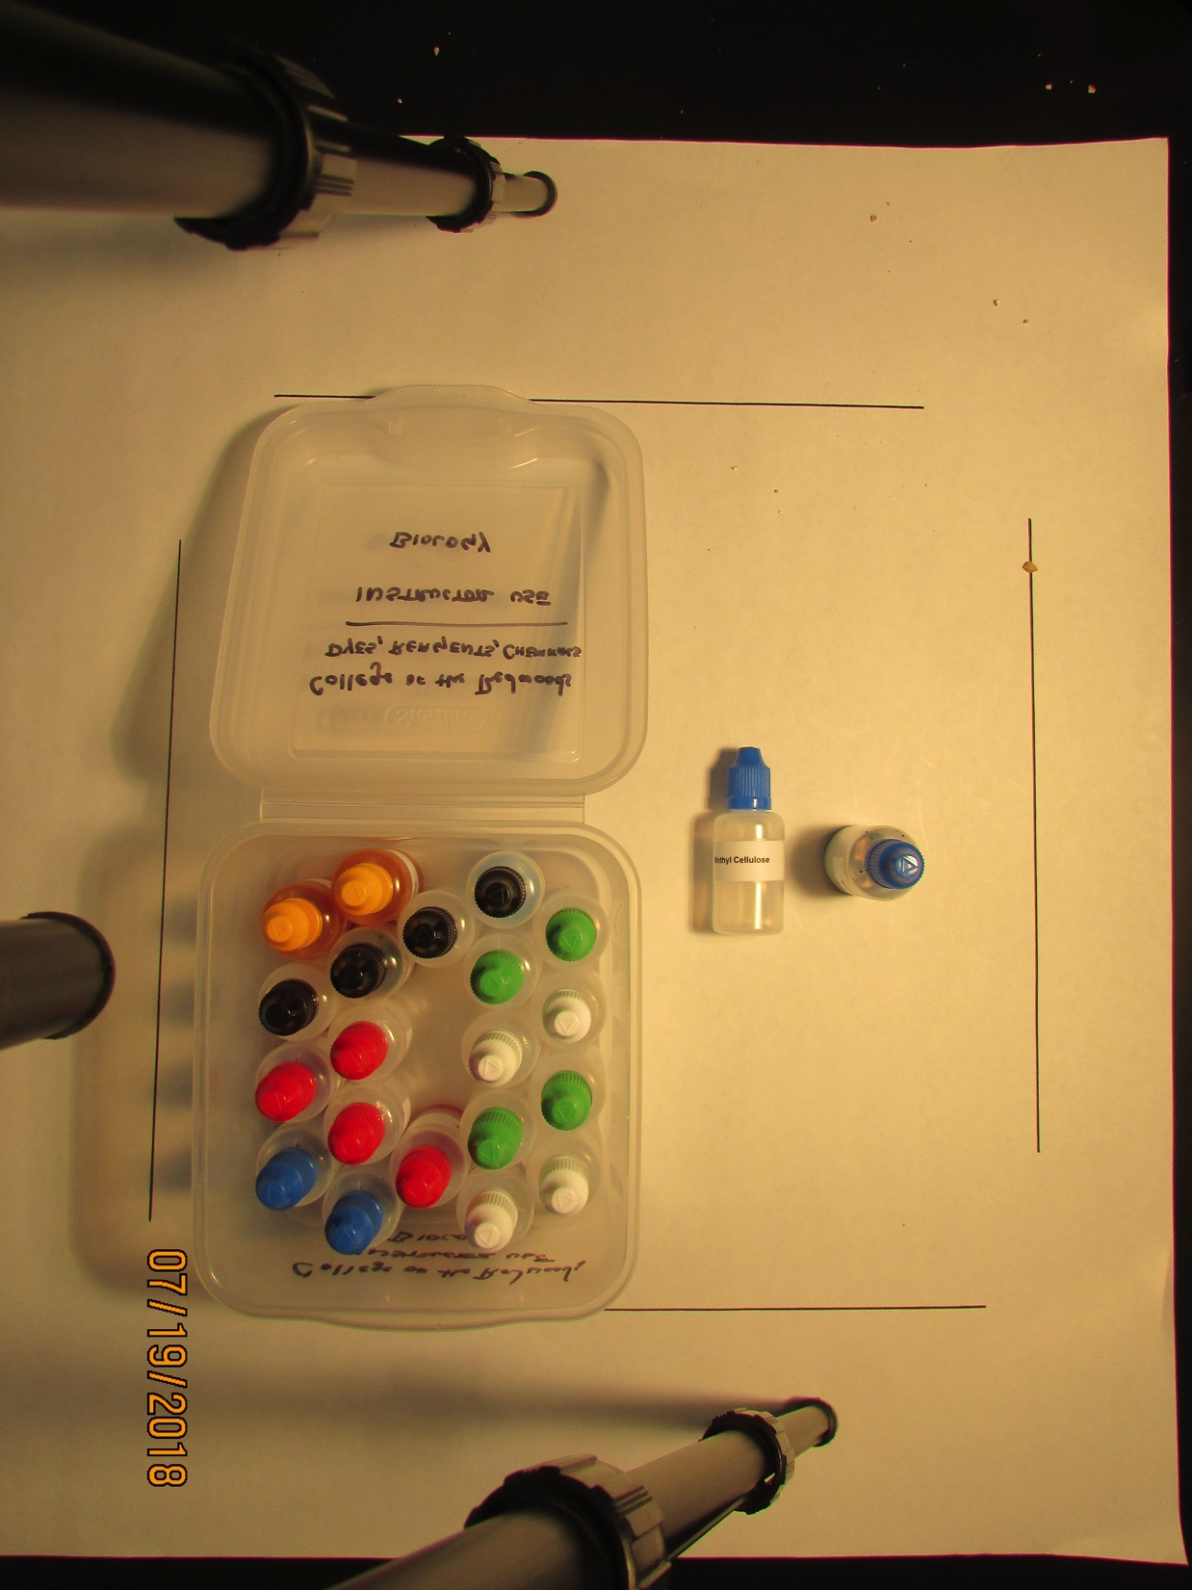
College of the Redwoods – Biology
11
12
1
2
8
3
4
10
5
9
6
7
INSTRUCTOR CHEMICAL/REAGENT DROPPER KIT
INVENTORY
2 iodine (yellow cap) 7. 2 methylene blue (blue caps)
2 Biuret’s reagent (black cap) 8. 2 10% bleach (green caps)
2 potassium permanganate (black caps) 9. 2 5% NaCl (salt water; green caps)
2 phenol red (red cap) 10. 2 lens cleaner (white caps)
2 carmine red (red cap) 11. 1 methyl cellulose (blue cap)
2 distilled water (white cap) 12. 1 blue food color (blue cap)
14

Slide 15
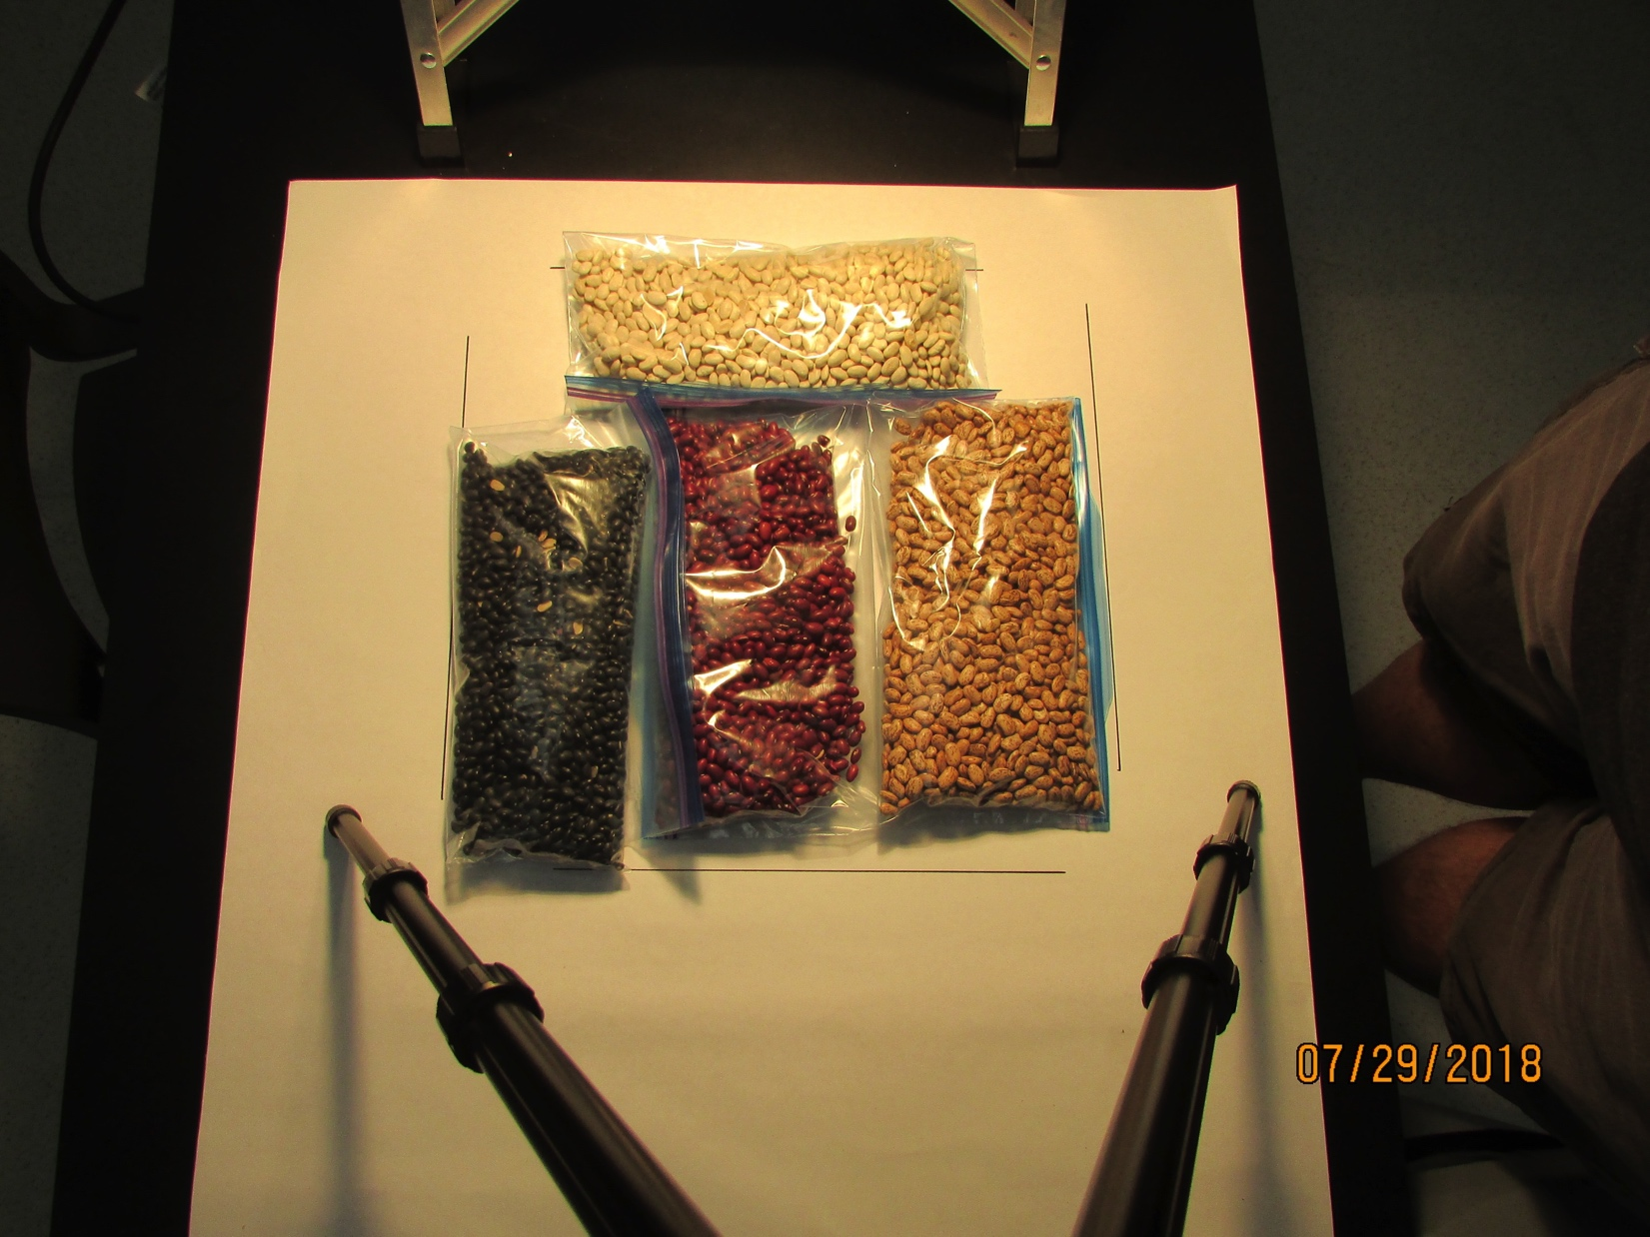
College of the Redwoods – Biology
1
3
2
4
Dry Beans
INVENTORY
1 zip-lock bag with dry white beans
1 zip-lock bag with dry black beans
1 zip-lock bag with dry red beans
1 zip-lock bag with dry pinto beans
15

Slide 16
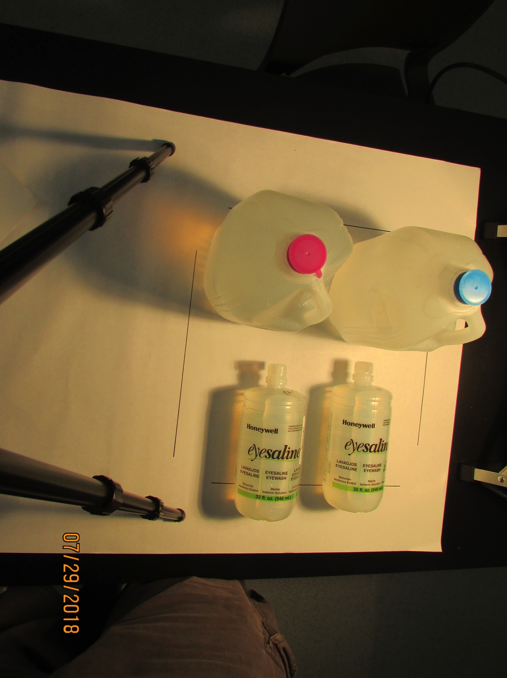
College of the Redwoods – Biology
1
2
3
Water and Saline
INVENTORY
1 gallon of distilled water
1 gallon of spring water
2 emergency eye wash bottles
16

Slide 17
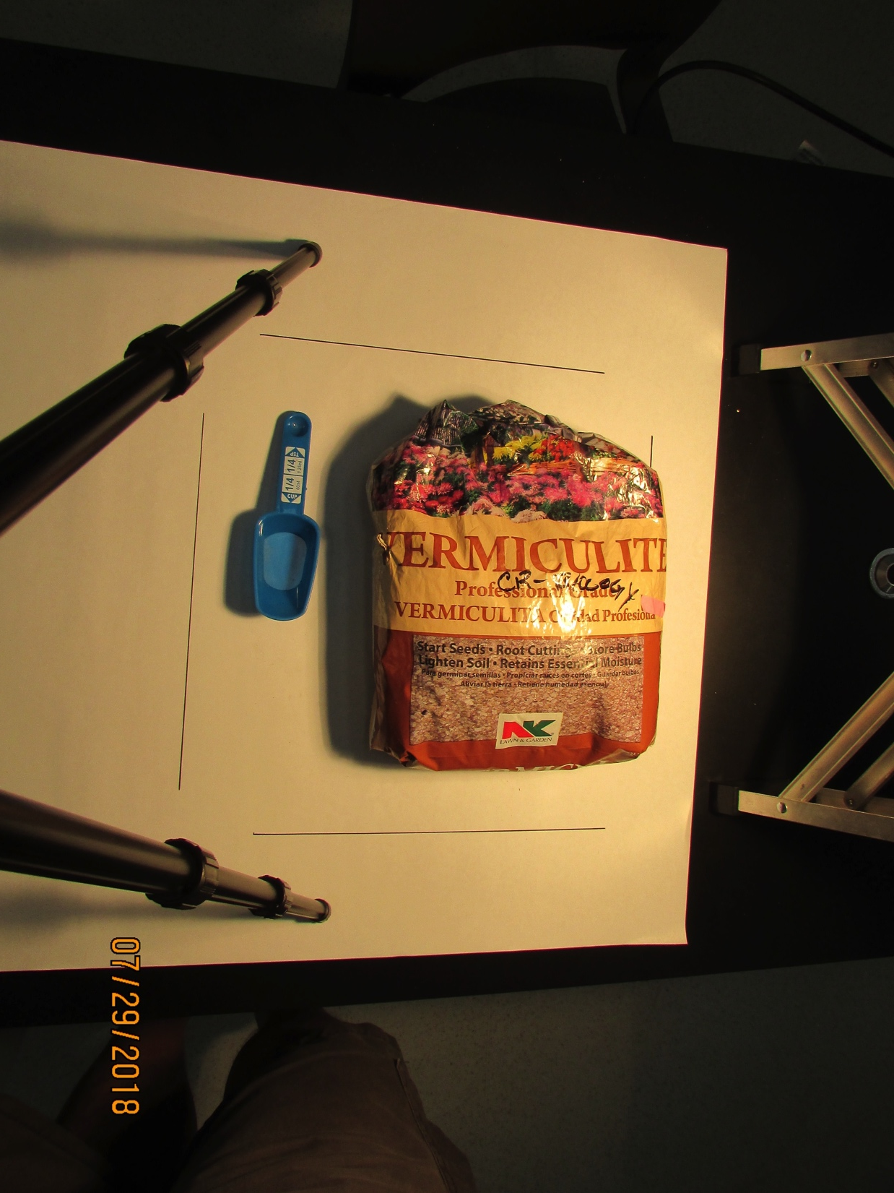
College of the Redwoods – Biology
1
2
Plant Medium Bin 1
INVENTORY
1 ¼ cup measuring scoop
1 bag of vermiculite medium
17

Slide 18
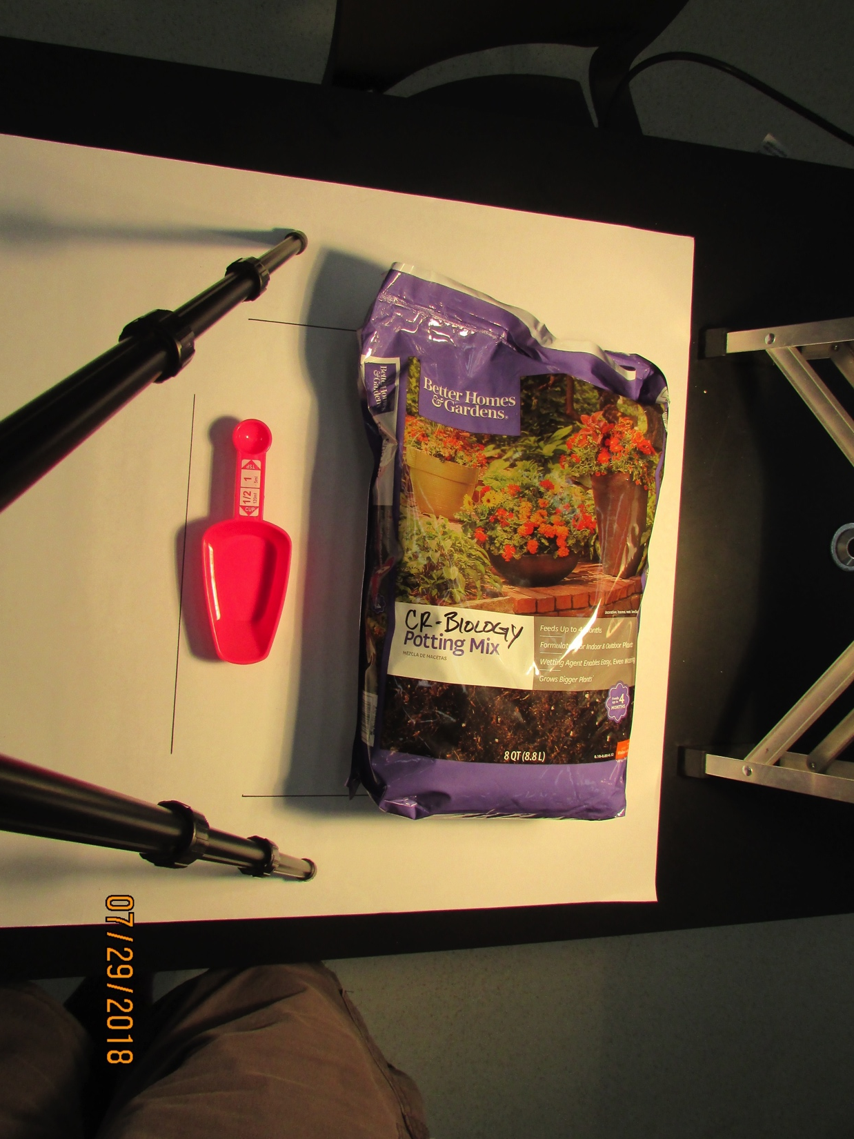
College of the Redwoods – Biology
1
2
Plant Medium Bin 2
INVENTORY
1 ½ cup measuring scoop
1 bag of potting soil medium
18

Slide 19
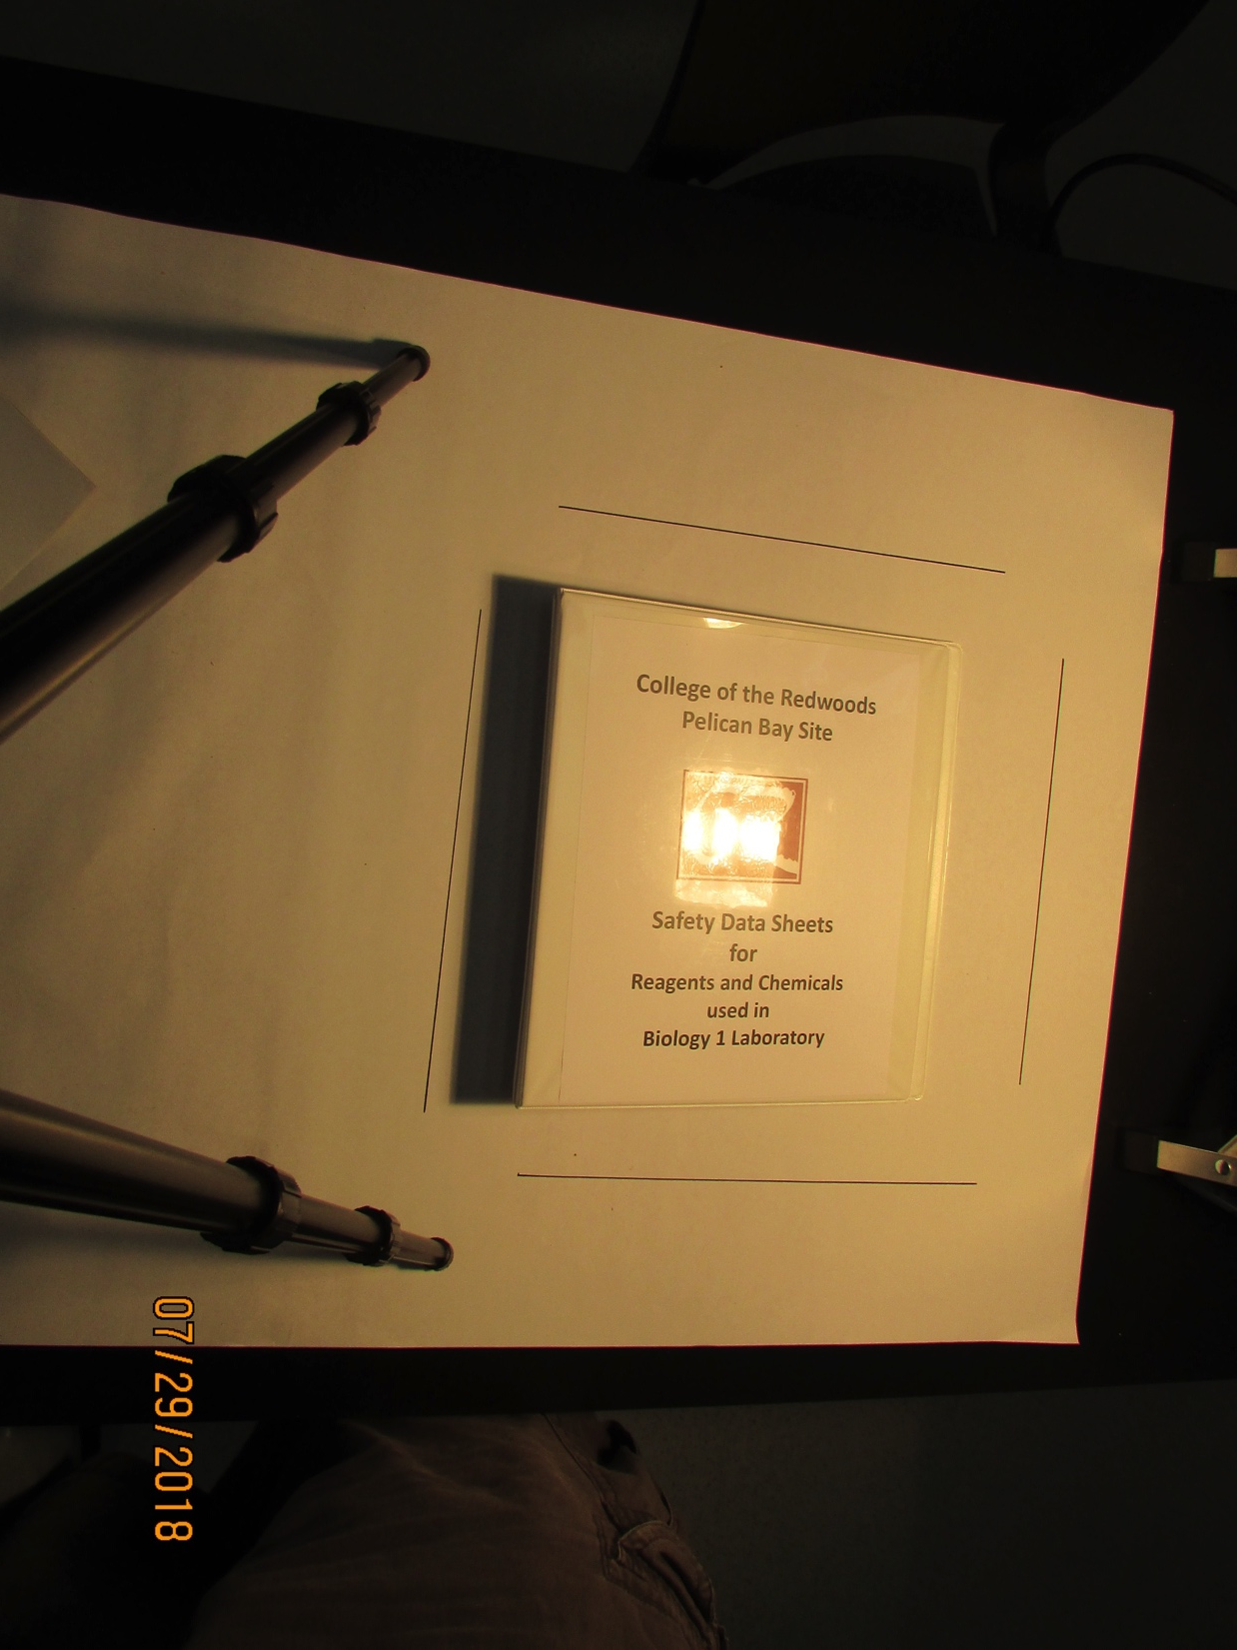
College of the Redwoods – Biology
(Material) Safety Data Sheets
for all chemicals used in Biology Lab
19

Slide 20
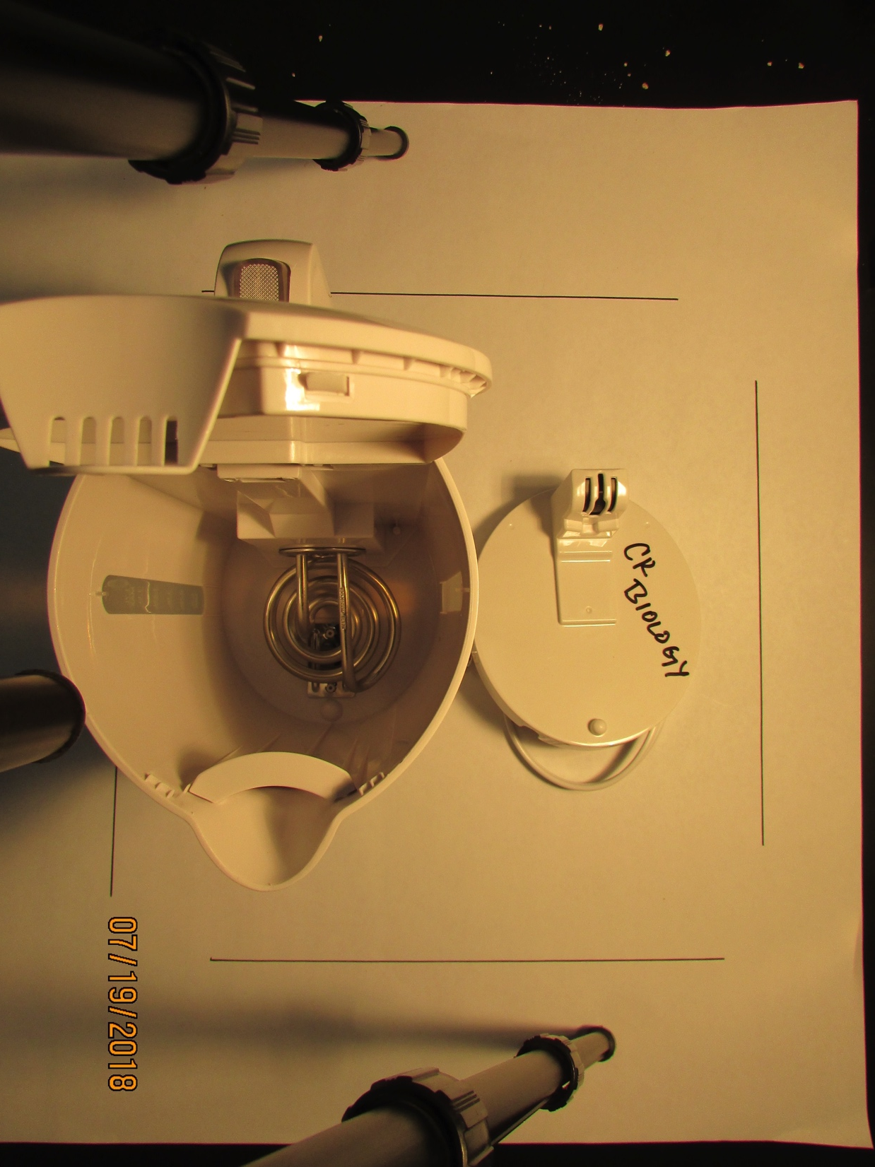
College of the Redwoods – Biology
Electric Tea Kettle
20

Slide 21
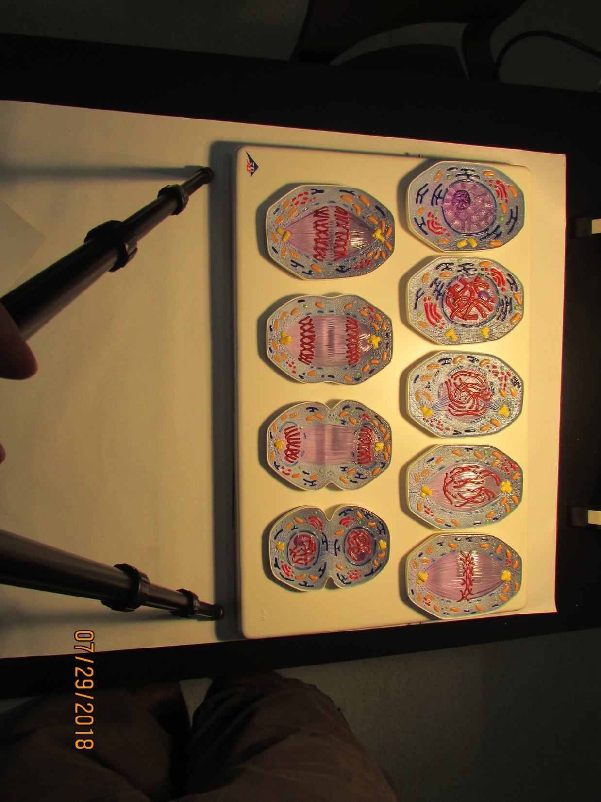
College of the Redwoods – Biology
Mitosis Model Set
1 model holder tray
9 cell models
21

Slide 22
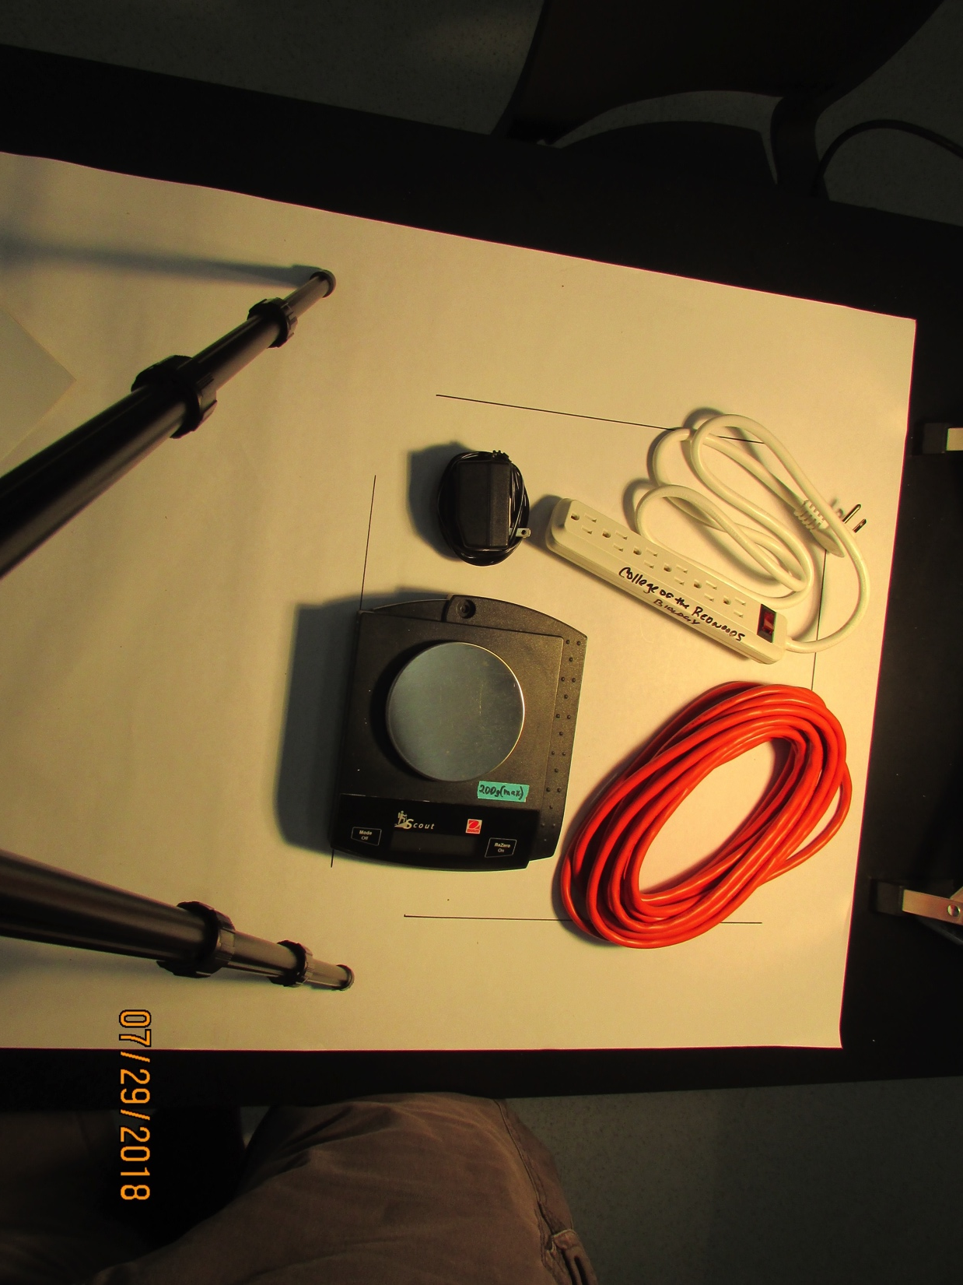
College of the Redwoods – Biology
2
3
1
4
Instructor Supply Bin #1
INVENTORY
1 Ohaus Scout electronic scale
1 power cord for electronic scale
2 AC power strips
6 AC extension cords (25’)
22

Slide 23
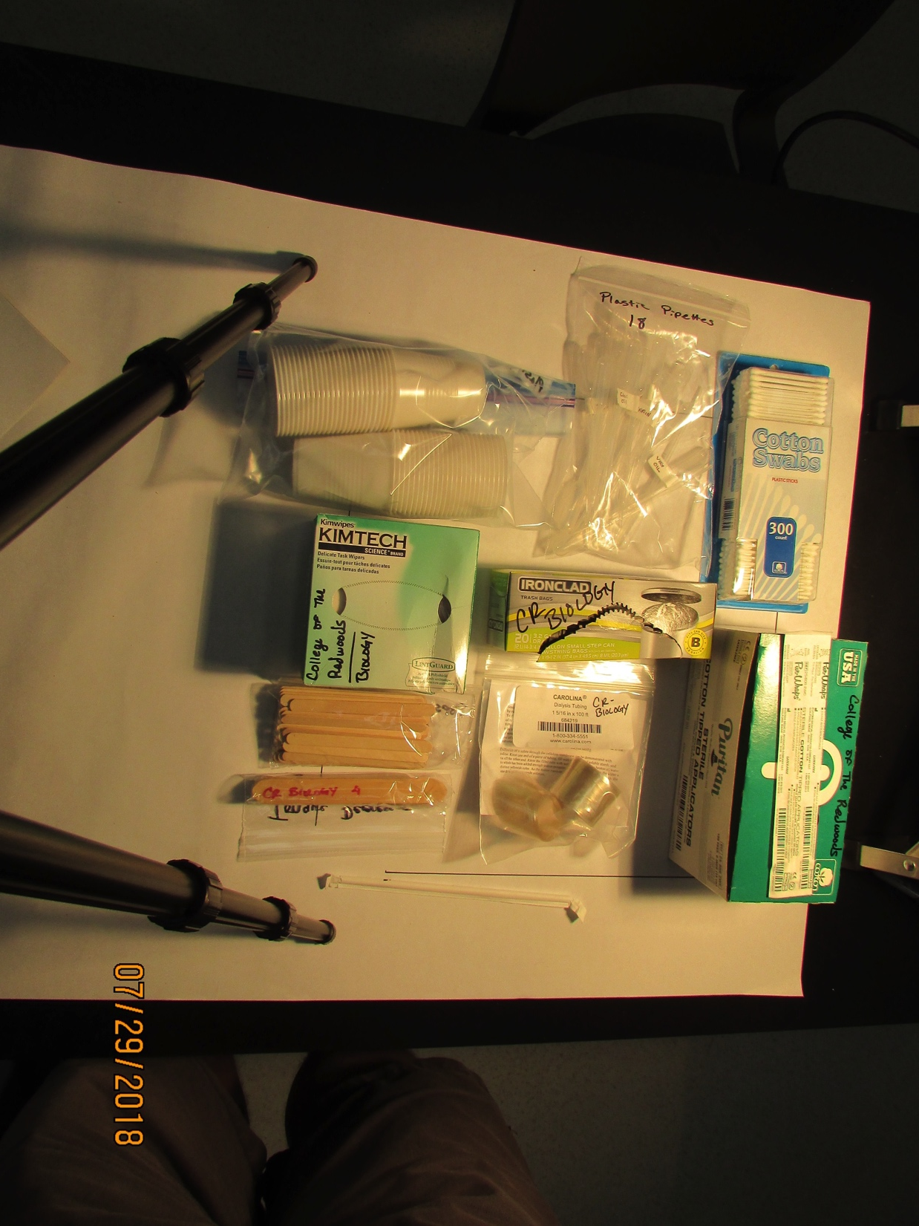
College of the Redwoods – Biology
1
2
3
4
5
6
7
9
8
10
Instructor Supply Bin #2
INVENTORY
50 disposable plastic cups 8. 6 tongue depressors
18 plastic pipettes in zip-lock bag 9. 1 roll of dialysis tubing
1 box of cotton swabs 10. paper wrapped straws (75)
2 boxes of lab tissues
1 box of small trash bags
1 box of sterile applicators (100)
50 popsicle sticks
23

Slide 24
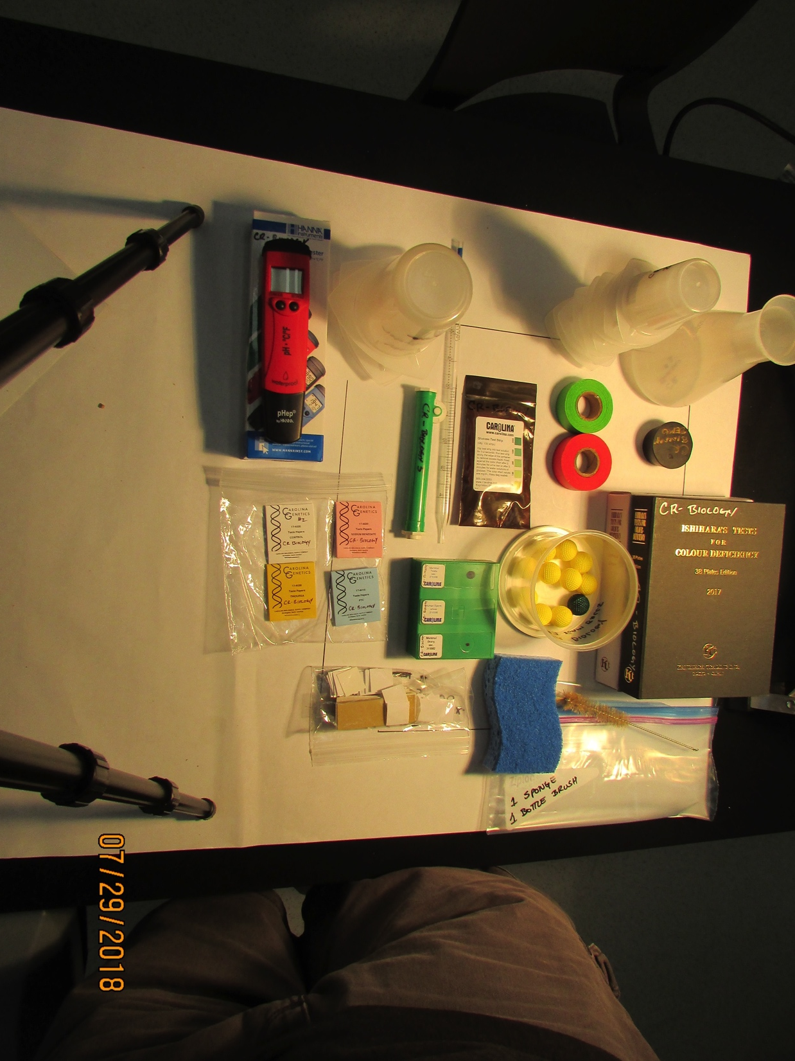
College of the Redwoods – Biology
1
2
4
3
5
8
9
7
6
10
11
16
12
13
14
15
Instructor Supply Bin #3
INVENTORY
1 electronic pH probe 11. 1 tub of foam balls (11)
3 tri-pour beakers (300ml) 12. Ishihara Color Blind Test Book
7 plastic pipettes (5ml) 13. 1 bag of plastic slides & cover
6 tri-pour beakers (100ml) slips (approx. 50 each)
1 plastic Erlenmeyer flask (500ml) 14. sponge
1 rubber stopper #10 15. bottle brush
2 rolls of label tape (red & green) 16. 1 box w/ 3 glass demo slides
1 bag of glucose test strips (sperm smear, ovary, testis
5 pipetters
Tasting papers (Control, PTC, Sodium Benzoate, Thiourea)
24

Slide 25
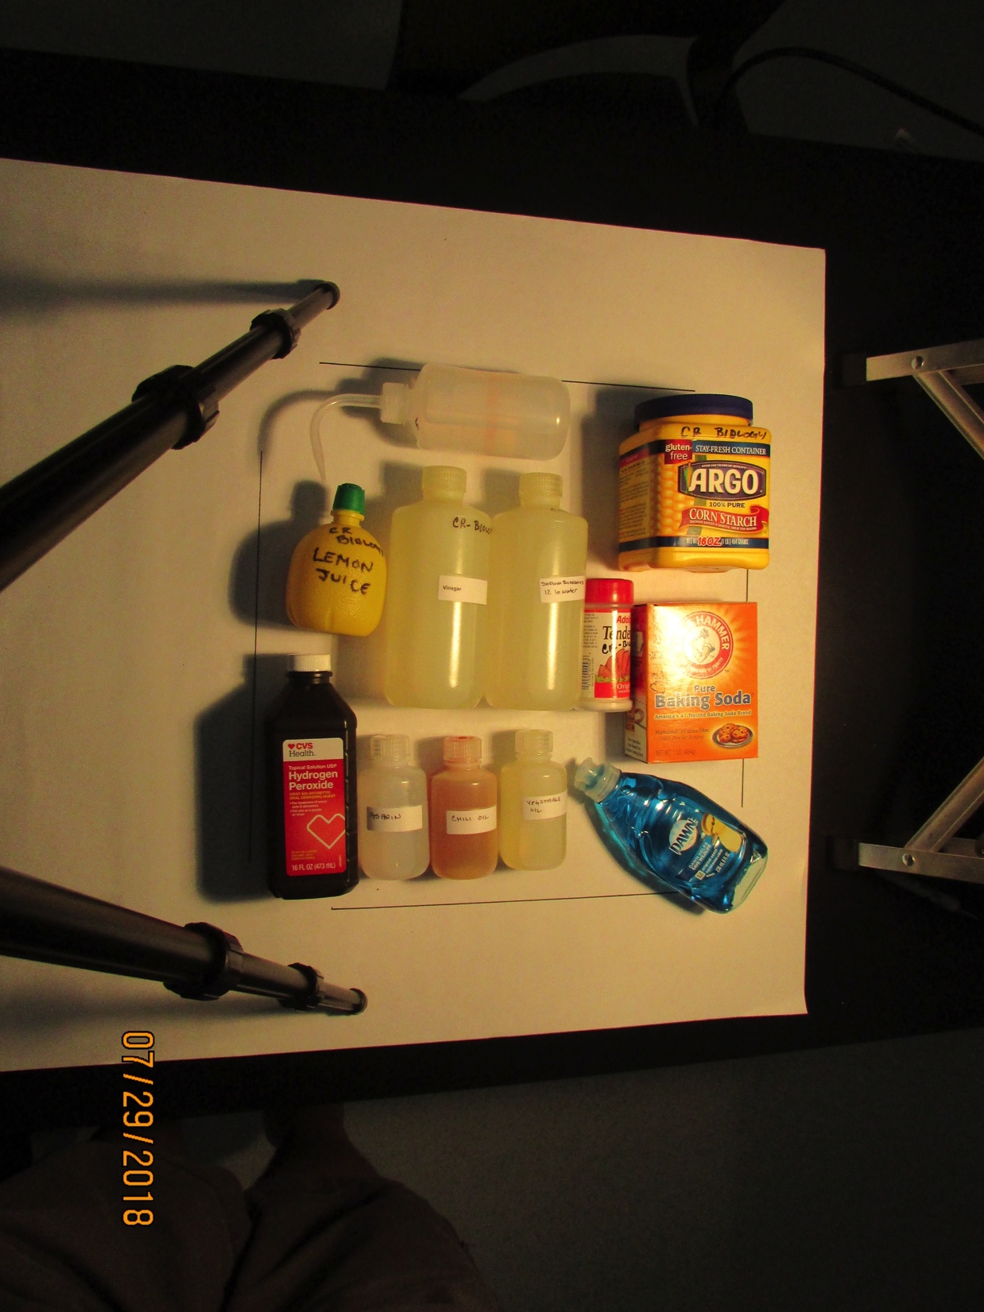
College of the Redwoods – Biology
2
3
1
4
5
6
7
8
9
12
10
11
Instructor Supply Bin #4
INVENTORY
1 bottle of lemon juice 10. Chili Oil (250ml)
6 distilled water squeeze bottles 11. Vegetable Oil (250ml)
corn starch (16oz) 12. Dawn Dish Soap
Vinegar (500ml)
1% Sodium Bicarbonate Solution (500ml)
Adolf’s Meat Tenderizer
1 box of baking soda
Hydrogen Peroxide (16oz)
1% Aspirin Solution (250ml)
25

Slide 26
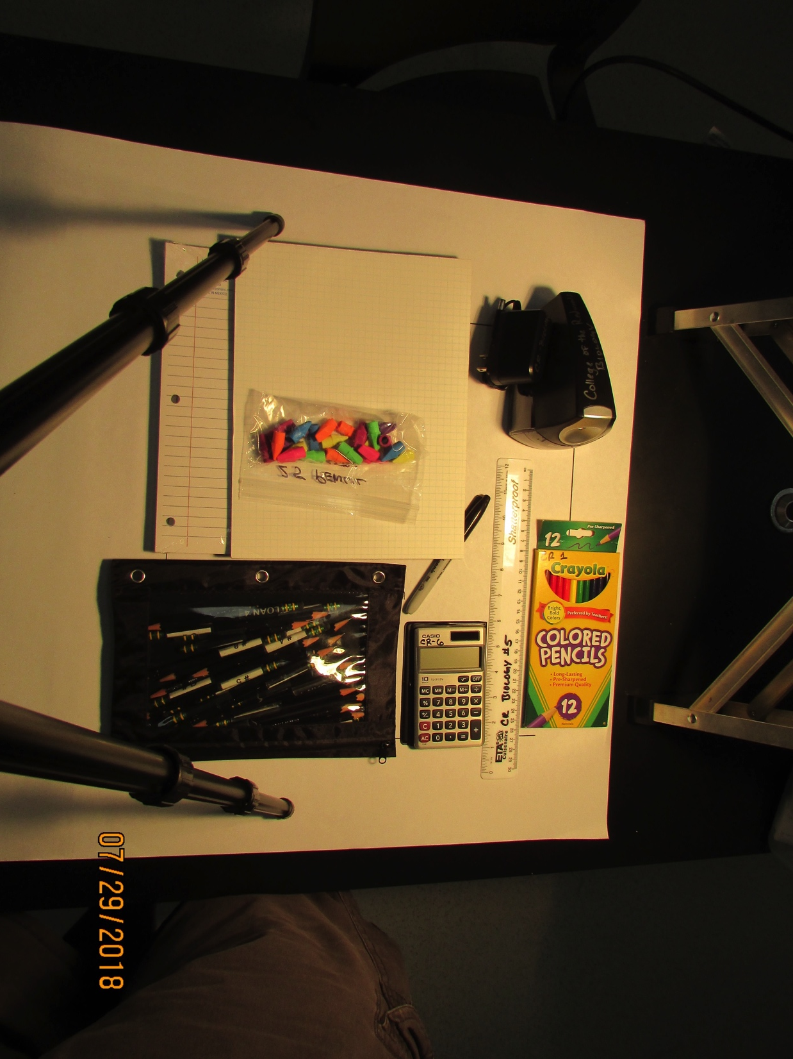
College of the Redwoods – Biology
2
1
3
4
6
5
8
9
7
Instructor Supply Bin #5
INVENTORY
1 ream of lined paper
1 pad of graphing paper
electric pencil sharpener w/ power cord
Pencil erasers in zip-lock bag (25)
6 black Sharpie markers
6 plastic rulers
6 boxes of colored pencils (12 colors)
1 pencil bag with 30 pencils
6 Casio calculators w/ vinyl cover
(not photographed 24 laminates)
6 onion cells
6 periodic table
6 genetic code
6 sea star embryos
26

Slide 27
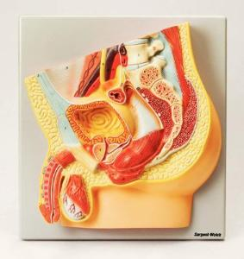
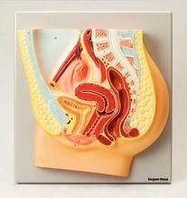
College of the Redwoods – Biology
1
2
Human Torso Models
1 male model, no removeable parts
1 female model, no removeable parts
27

Slide 28
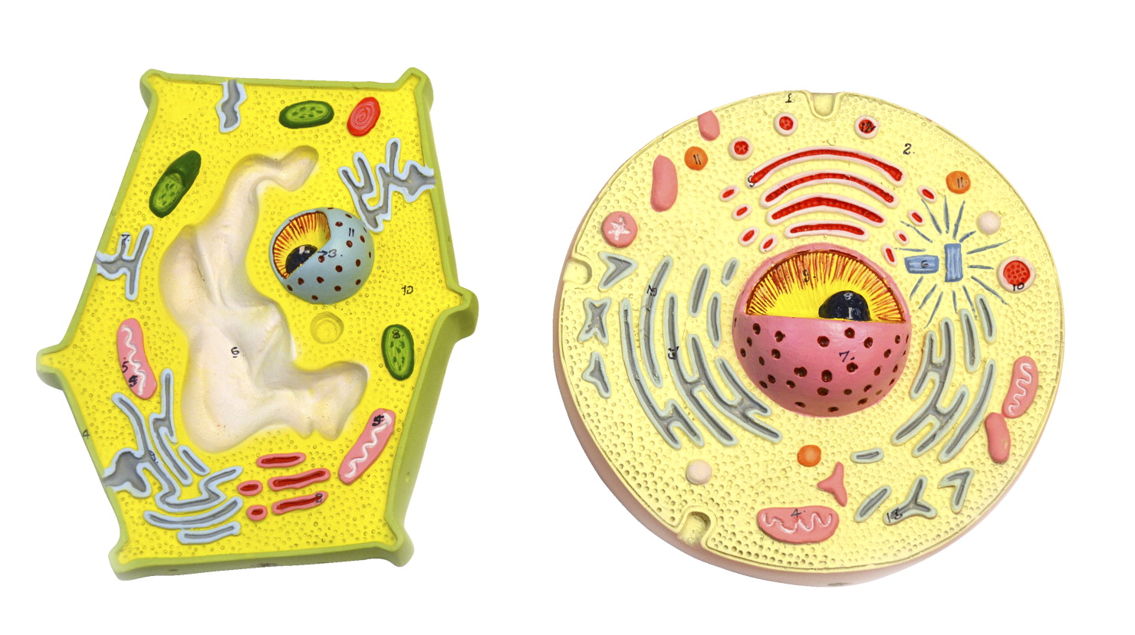
College of the Redwoods – Biology
1
2
Plant and Animal Cell Models
1 plant cell model, no removeable parts
1 animal cell model, no removeable parts
28

Slide 29
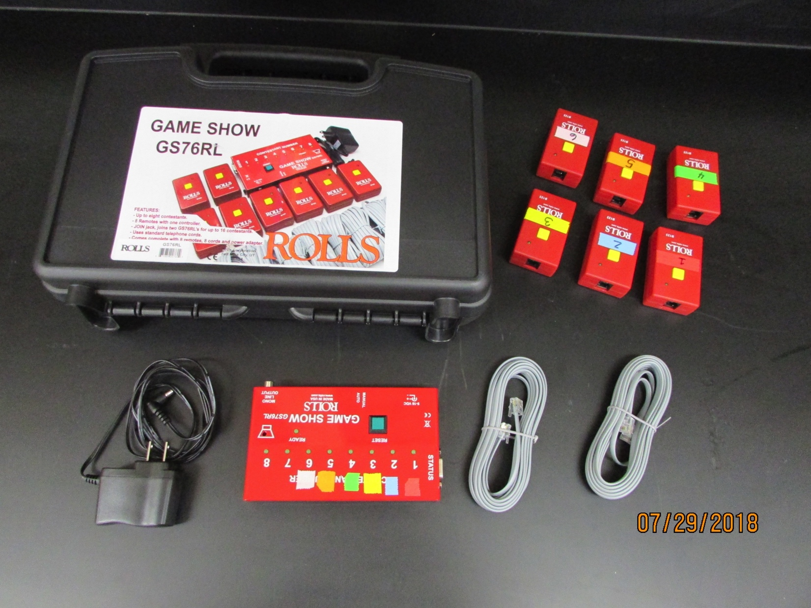
College of the Redwoods – Biology
1
2
4
5
3
Game Show Buzzers
1 carrying case
6 buzzers
1 AC power cord
1 control box
6 telephone cords
29

Slide 30
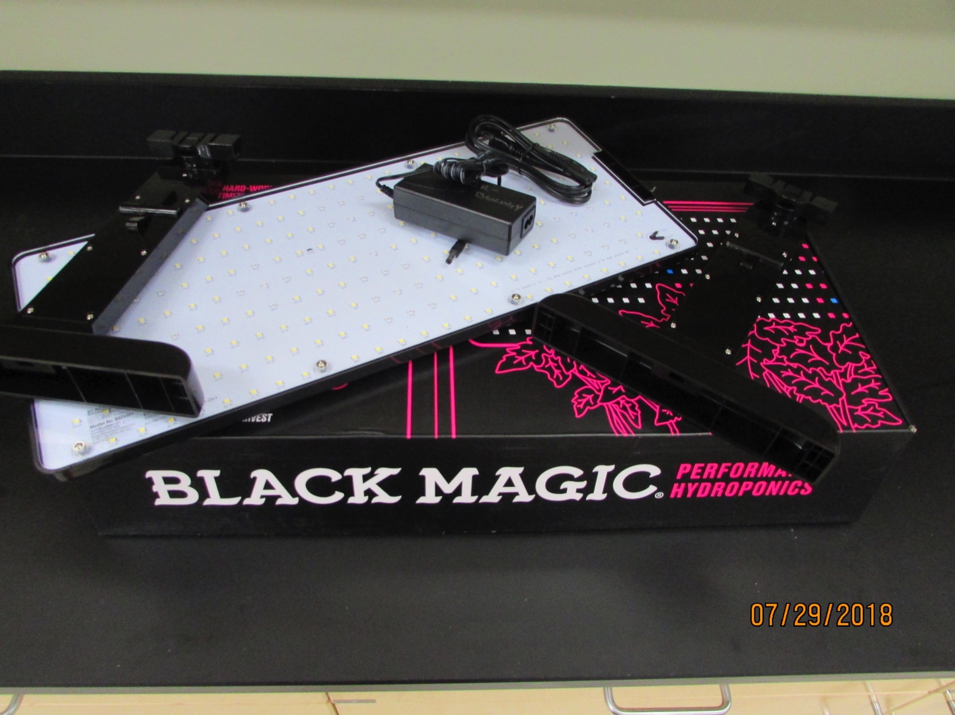
College of the Redwoods – Biology
1
4
2
3
LED Grow Light
1 storage box
2 leg stands
1 LED light panel
1 AC power cord
30

Slide 31
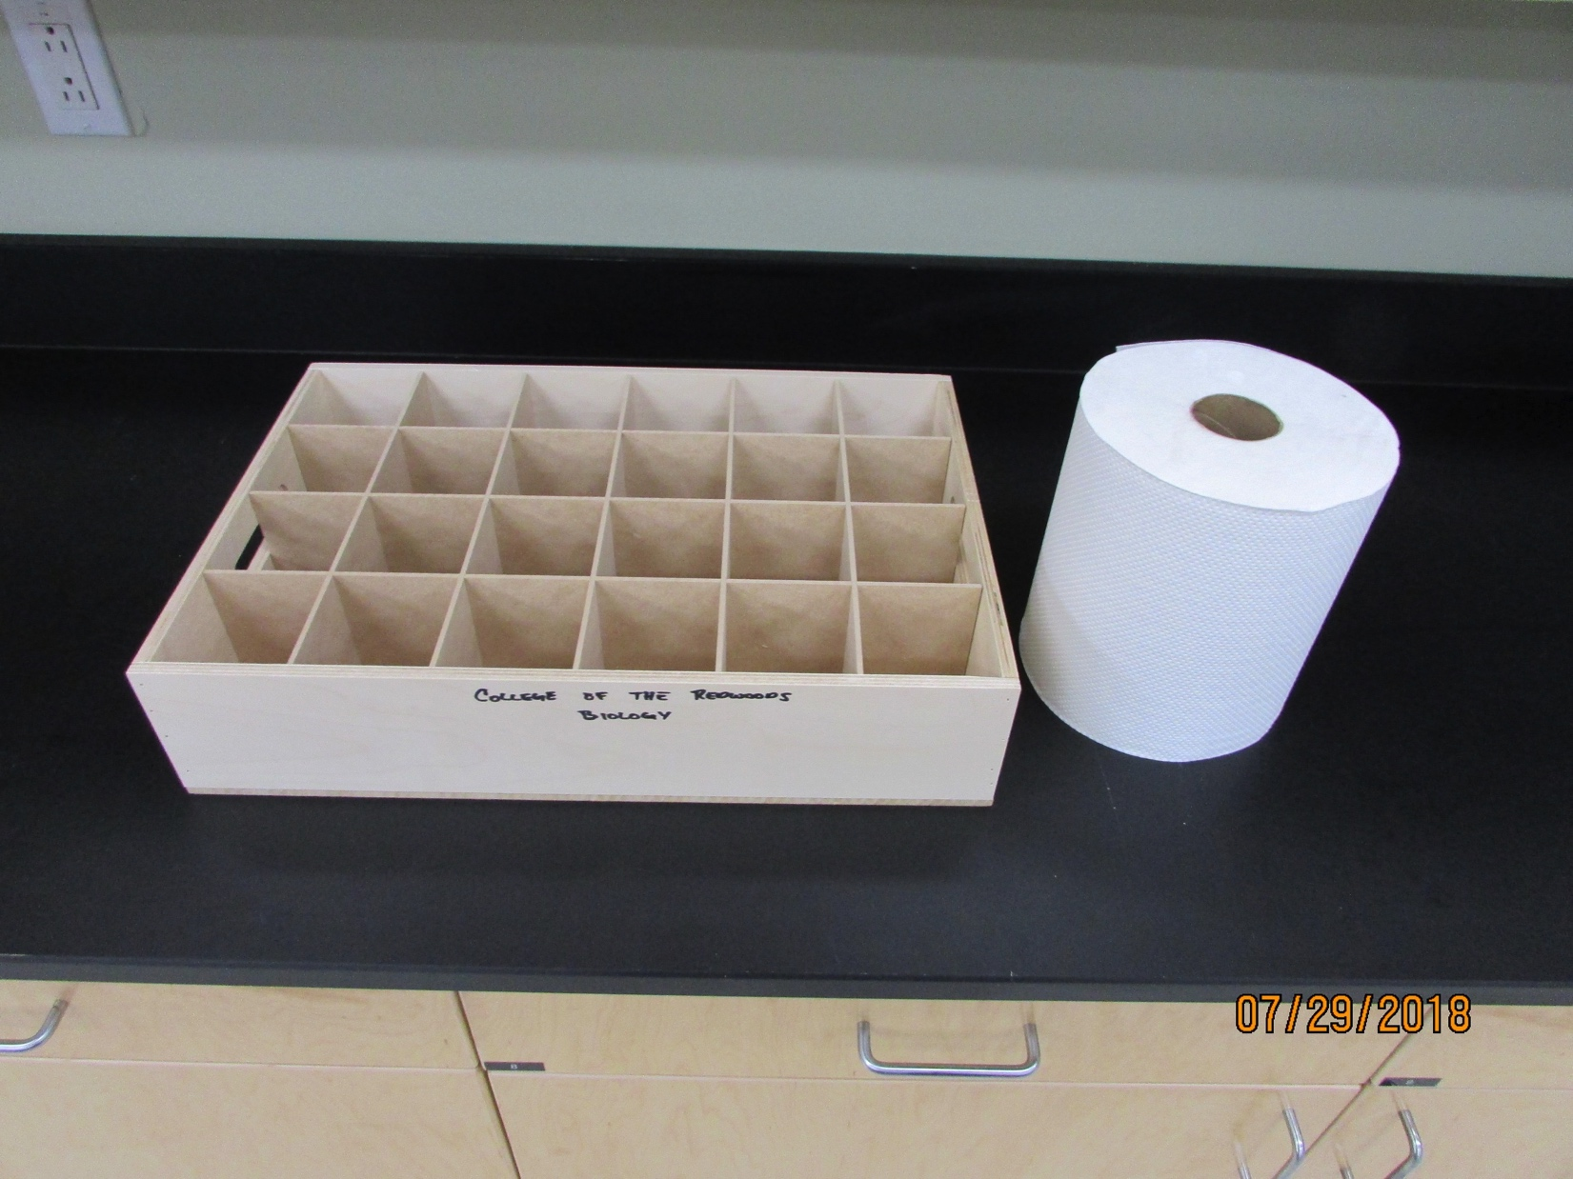
College of the Redwoods – Biology
1
2
Plant Lab Supplies
1 wooden soda bottle crate
1 roll of paper towels
31

Slide 32
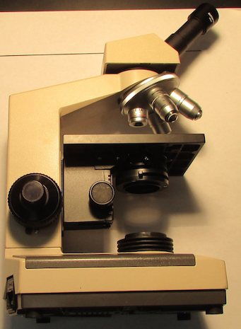
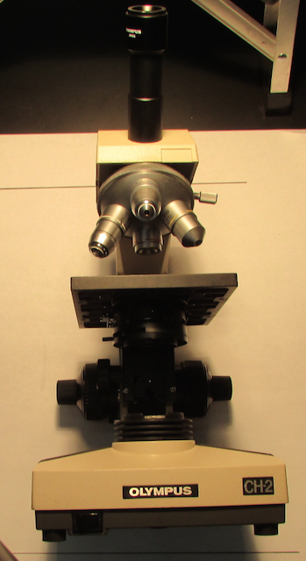
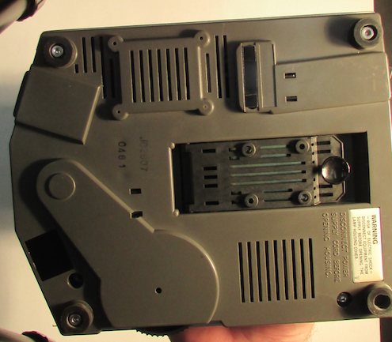
College of the Redwoods – Biology
2
4
3
1
5
6
bottom view
Compound Microscope
6 Olympus CH-2 Compound Microscopes* must include all of the following parts:
1 ocular lens
4 objective lenses
1 ocular thumb screw
1 iris diaphragm with thumb screw
1 light bulb
*Mechanical stage parts have been removed and are
not inventoried
32

